Slide 1
Engaging older adults: Research and best practices for success in mental health treatment
Jess Bibbo Ph.D, Sr. Research Scientist
Tamar Cooper, LISWS, LICDC-CS
Director of Behavioral Health Service
Benjamin Rose
Cleveland, Ohio

Slide 2
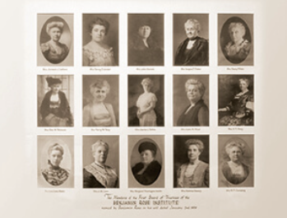
Benjamin Rose
Founded in 1908
Benjamin Rose is an over 110-year old Cleveland-based nonprofit organization whose mission is to support caregivers and empower all people to age well through research, consumer-responsive services and client advocacy. We work on the cutting edge of the aging experience, aiming always to inspire and enlighten.

Slide 3
Benjamin Rose
Behavioral Health Services
Health and Wellness Services
Home-delivered Meals
Senior Centers
Financial Wellness
Affordable & Supportive Housing
Evidence-based Caregiver Support Programs

Slide 4
Behavioral Health Services
Mental health case management, CARF-certified mental health day treatment; counseling and psychotherapy; diagnostic and evaluation- all offered either in person or telehealth.
Offer ongoing presentations on variety of mental health topics to both professionals, caregivers, public on issues related to aging
Staff trained in providing Mental Health First Aid through state funded Mental Health America

Slide 5
Behavioral Health Services
Trained staff in the field of aging, cutting edge issues that impact older adult.
Cyber romance scams, hoarding, grief and loss, linkage and education, partners with senior housing, suicide and the older adult.
Our success: Older adults have a lifetime of experience. Sharing that with someone who often times is half their age is difficult.
Staff remembering to validate and respect the person where they are at is the key to building a foundation for treatment.

Slide 6
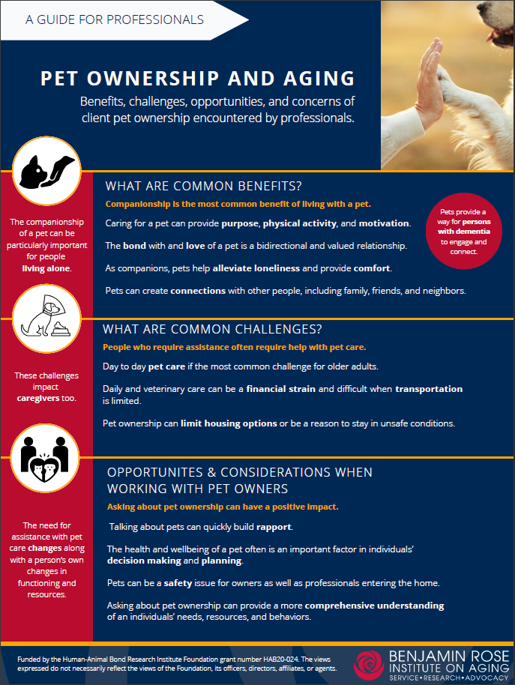
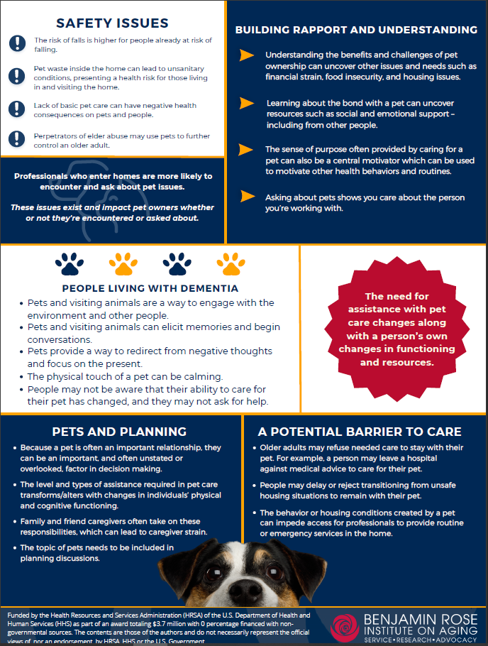
Center for Research & Education
Established in 1961
Conducts research projects and develops evidence-based practices to benefit older adults, their families, and service providers.
Specialty areas
Active Aging
Family Caregiving
Elder Abuse
Program Evaluation
Consumer Satisfaction
Long-term and Residential Care
Services & Interventions

Slide 7
Learning Objectives
Attendees will be able to identify specific challenges and strengths of aging.
Attendees will be able to describe techniques to engage and build rapport with older adults.
Attendees will be able to recognize signs of cognitive impairment.
Attendees will be able to describe the importance of research on mental health services for older adults.

Slide 8
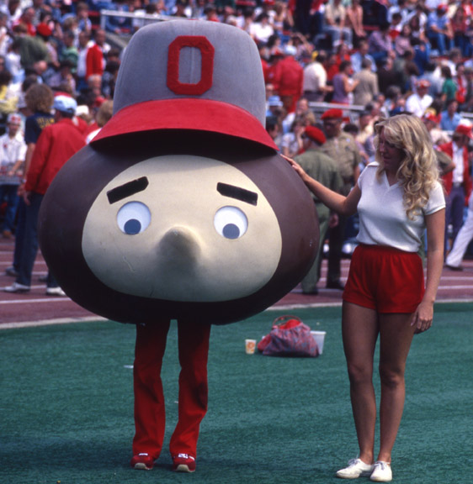
Brutus Buckeye turns 59 in 2024
Between 2020 and 2024 Ohio’s population of those 60 and older is expected to grow more than 4x the state’s overall population, including a 51% increase in the portion of Ohioans 85 and older
It’s more important than ever that community social workers, therapists, and other professionals should have the knowledge on how to work with this older population!

Slide 9
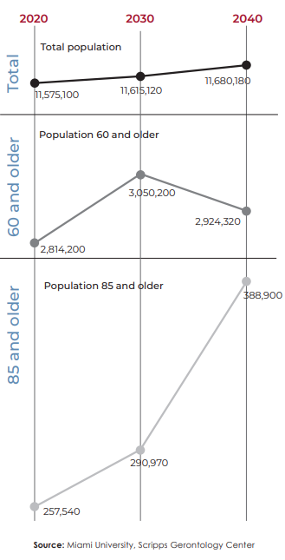
An Aging Population
Notes:
Population growth
Life expectancy
The “oldest-old”

Slide 10
Is 60 really the new 30? Engaging and keeping older adults in mental health treatment
The first meeting sets the tone for the relationship
Importance of cultural and age-related sensitivity from the first introduction.
Respect: Ask how the person would like to be referred to Ms., Mr., etc.
Cultural, generational norms and beliefs
Awareness of older adult's feelings and stigma of mental illness

Slide 11
Is 60 really the new 30? Engaging and keeping older adults in mental health treatment
Older adults come into treatment with more life experience and tend to have more medical, physical, psychosocial issues.
They will age which brings on more challenges.
Professionals must be more than just generalists to adequately address the mental health and social needs for this fast growing population in Ohio.

Slide 12
Addressing the Mental Health Needs of Older Adults
Hybrid approach-community based visits combined with telehealth; meeting client needs based on a comprehensive assessment.
Breaking down assessment; ease for client not clinician.
Cultural sensitivity
Values, environment, acceptance, respect—you are a guest in their home/life
Cutting edge issues that impact older adults—cyber romance scams, hoarding, linkage and education, partner with senior housing.
Education re: grief and loss, alliance with major agencies, service providers and other social service providers
Normalizing aging
Linkage with other service providers.

Slide 13
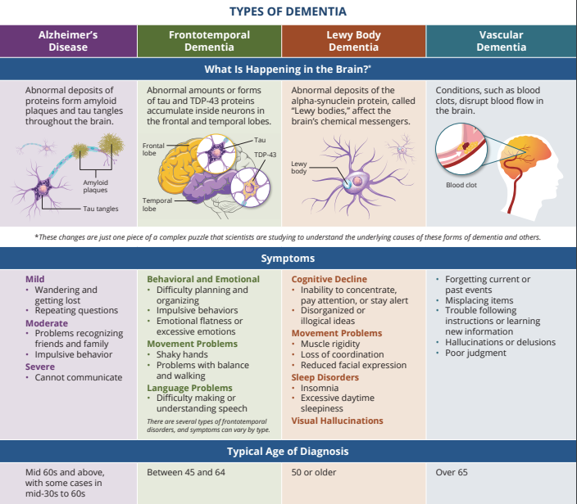
httpshttps://www.nia.nih.gnfographics
www.nia.nih.gov/health/infographics/understanding-different-types-dementia
Notes:
In the first nationally representative study(link is external and opens in a new window) of cognitive impairment prevalence in more than 20 years, Columbia University researchers have found almost 10% of U.S. adults ages 65 and older have dementia, while another 22% have mild cognitive impairment. People with dementia and mild cognitive impairment are more likely to be older, have lower levels of education, and to be racialized as Black or Hispanic. Men and women have similar rates of dementia and mild cognitive impairment.
“Dementia research in general has largely focused on college-educated people who are racialized as white,” says Manly.
https://www.cuimc.columbia.edu/news/one-10-older-americans-has-dementia#:~:text=In%20the%20first%20nationally%20representative,22%25%20have%20mild%20cognitive%20impairment.

Slide 14
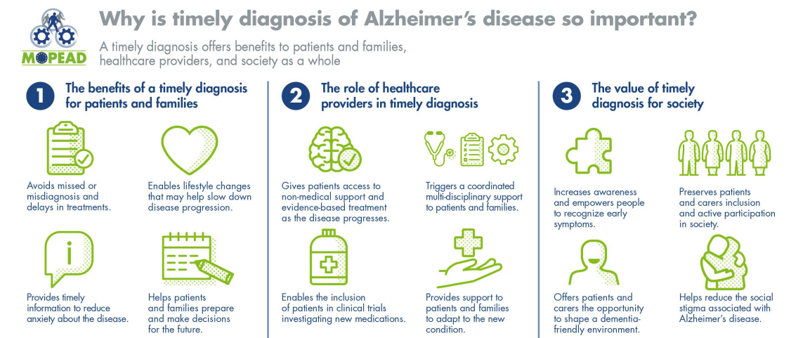
Importance of Early Diagnosis
https://www.imi-neuronet.org/materials/
Notes:
In the first nationally representative study(link is external and opens in a new window) of cognitive impairment prevalence in more than 20 years, Columbia University researchers have found almost 10% of U.S. adults ages 65 and older have dementia, while another 22% have mild cognitive impairment. People with dementia and mild cognitive impairment are more likely to be older, have lower levels of education, and to be racialized as Black or Hispanic. Men and women have similar rates of dementia and mild cognitive impairment.
“Dementia research in general has largely focused on college-educated people who are racialized as white,” says Manly.

Slide 15
Depression in Older Adulthood
At increased risk
Often misdiagnosed
Undertreated
May not seek help
More successful at suicide
Silent suicide
Can be successfully treated
Physical health impact
Notes:
Depression can have many etiologies, including social isolation; loneliness;
acute changes in health, such as a myocardial infarction or stroke;
and chronic health conditions, such as cancer or pain, as well as socioeconomic
and genetic causes (Fiske et al. 2009). Although less than 5%
of older adults in the community live with major depressive disorder
(Centers for Disease Control and Prevention 2021), this rate rises to
more than 10% when an older adult is hospitalized or requires home
health care. Depression is associated with decline in cognitive functioning
(Donovan et al. 2017) and mortality (Schulz et al. 2000), as well as
presentations involving somatic complaints (e.g., insomnia, pain) or
irritability (Fiske et al. 2009). Depression can be successfully treated inand doing so also may increase physical functioning (Callahan
et al. 2005).
A systematic review of the literature found that depressive disorders
were the most common risk factor for suicidal behavior in older adults
(Beghi et al. 2021). In addition to depression, other risk factors for suicide
in older adults include social isolation, perceived poor health, barriers
to access to psychotropic medication, impaired sleep, previous
suicide attempts, chronic diseases (e.g., cancer), and functional impairment
(Fässberg et al. 2016). The lethality rate of attempted suicide increases
with age and is higher in males than in females (Dombrovski et
al. 2008). Although these statistics are alarming, interventions that promote
a holistic view of health and well-being, including social connectedness,
can have a positive effect on older adults at risk for suicide
(Conwell 2014).

Slide 16
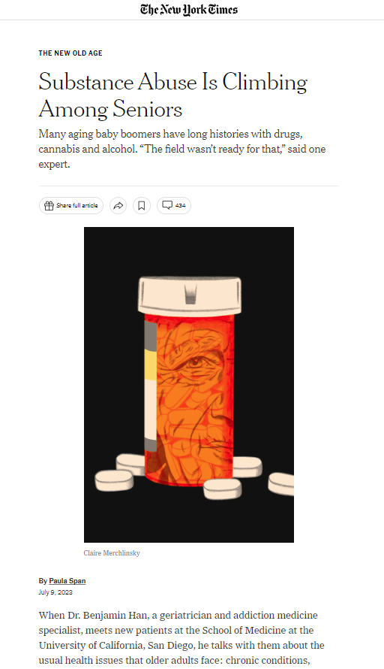
Substance Abuse
Bodies process substances differently as we age
Impact of prescription Rx
Understudied
Older adults do respond to treatment
https://www.nytimes.com/2023/07/09/health/seniors-substance-abuse.html
Notes:
While use of illicit drugs in older adults is much lower than among other adults, it is currently increasing.
Older adults are often more susceptible to the effects of drugs, because as the body ages, it often cannot absorb and break down drugs and alcohol as easily as it once did.
Older adults are more likely to unintentionally misuse medicines by forgetting to take their medicine, taking it too often, or taking the wrong amount.
Some older adults may take substances to cope with big life changes such as retirement, grief and loss, declining health, or a change in living situation.
Most admissions to substance use treatment centers in this age group are for alcohol.
Many behavioral therapies and medications have been successful in treating substance use disorders, although medications are underutilized.
It is never too late to quit using substances—quitting can improve quality of life and future health.
More science is needed on the effects of substance use on the aging brain, as well as into effective models of care for older adults with substance use disorders.
Providers may confuse symptoms of substance use with other symptoms of aging, which could include chronic health conditions or reactions to stressful, life-changing events.
https://nida.nih.gov/publications/drugfacts/substance-use-in-older-adults-drugfacts

Slide 17
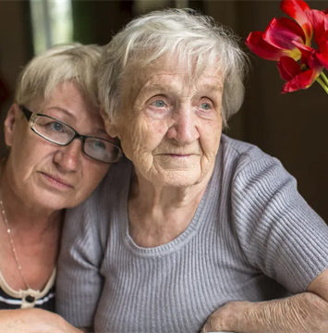
Telephone- and email-based care-coaching program that assists and supports adults with or at-risk for developing dementia, including those with intellectual and developmental disabilities, and their family and friend caregivers, or other supports.

Slide 18
A personal Care Consultant helps with:
Finding and getting connected to health and community services
Prioritizing concerns using a simple step-by-step plan based on YOUR needs
Communicating with loved ones, family, and friends about care and managing difficult situations and behaviors
Staying in touch with individuals and families so adjustments can be made as situations change
Assisting with getting other family and friends involved
Being there for YOU as an emotional support when overwhelmed or faced with challenges

Slide 19
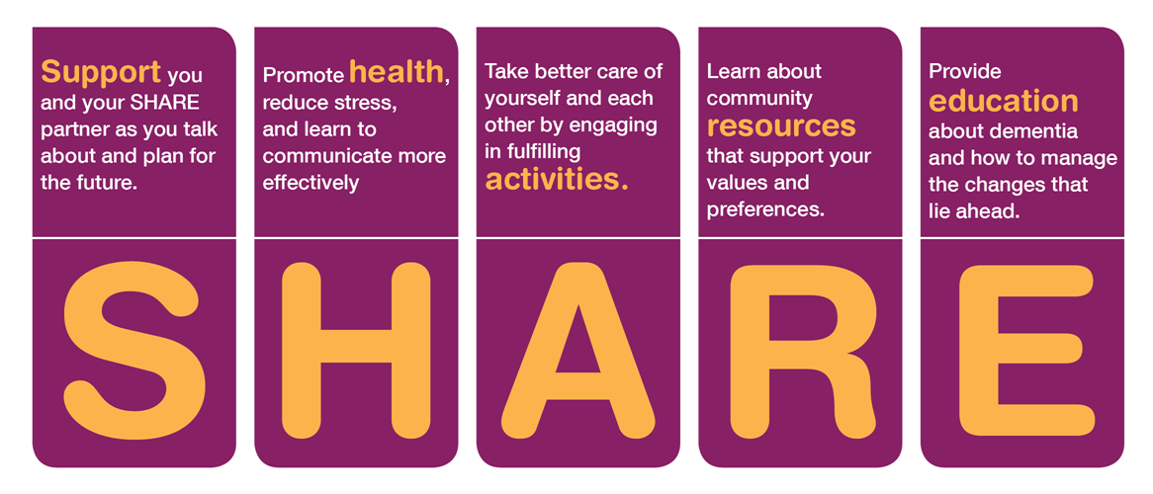
5 SHARE sessions + 6th optional Family Session for “SHARE Partners” – the person living with dementia and a family care partner.
SHARE Sessions are held weekly, lasting 60-90 minutes.

Slide 20
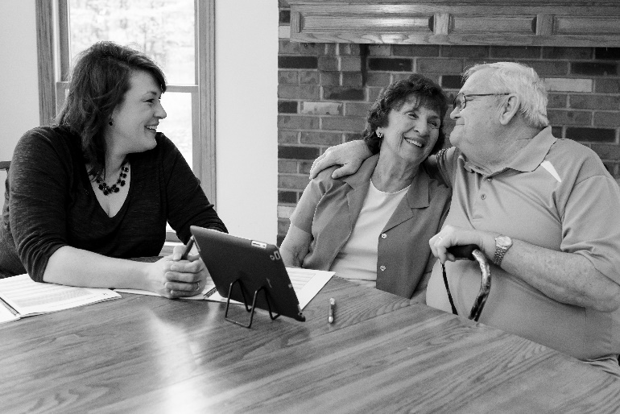
Guide
Support
Resource
Help - problem-solve through difficult decisions.
Assist - determine if what they plan is realistic.
Guide - towards decisions that are mutually acceptable.
Create a safe environment for care partners to share their points of view.
Help them communicate more effectively.
Provide support and validate their feelings and experience.
Answer questions about dementia and available resources.
Build - connection to services (support groups, early stage programs, etc).
Help - understand that they are not on this journey alone.
Notes:
SHARE Counselors are dementia care professionals from a variety of backgrounds. Typically, SHARE Counselors are social workers, counselors, geriatric care managers, nurses, and other professionals.
SHARE Counselors develop a strong therapeutic relationship that empowers families to connect to resources in the earlier stages of dementia.
The SHARE program provides these professionals and their organizations a powerful tool that helps families during this critical time in the disease process.

Slide 21
An Aging Population
Notes:
Population growth
Life expectancy
The “oldest-old”

Slide 22
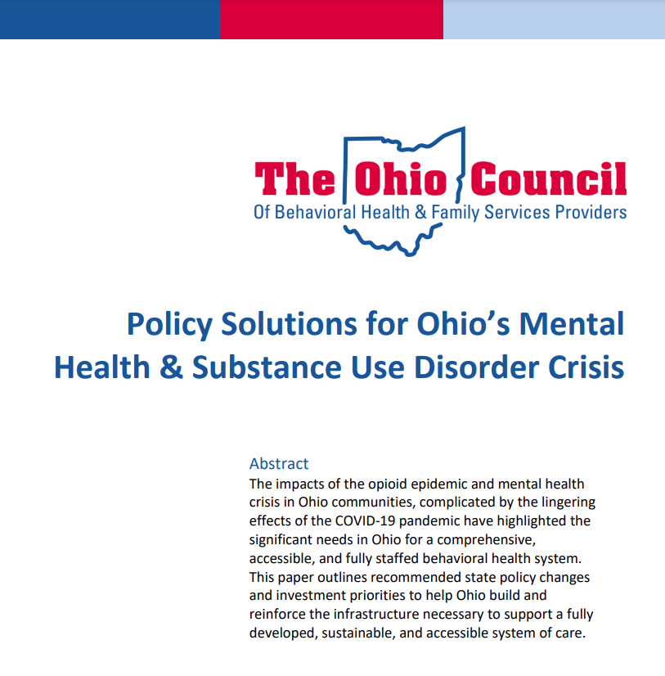
An Aging Population

Slide 23
Thank You
Jess Bibbo, PhD
jbibbo@benrose.org
Tamar Cooper, LISWS, LICDC-CS
tcooper@benrose.org

