Slide 1
The Ohio Model

Slide 2
The Ohio Council
1984 The Ohio Council on Problem Gambling is formed
The Brecksville VA Treatment
Ohio Lottery funds training for clinicians

Slide 3
PGNO
Problem Gambling Network of Ohio takes over the role of advocacy, training and support in 2006.

Slide 4
Ohio Lottery/ODADAS
Funding 5 programs in Cincinnati, Athens, Cleveland, Youngtown, and Toledo.
Columbus added when casino sites are announced
Dollars for training
Casino Control Commission is created

Slide 5
2011
Survey
NCPG Conference
Ohio Conference
Increase in money
GAMB endorsement
Training
ORG formed in 2013/PGAB

Slide 6
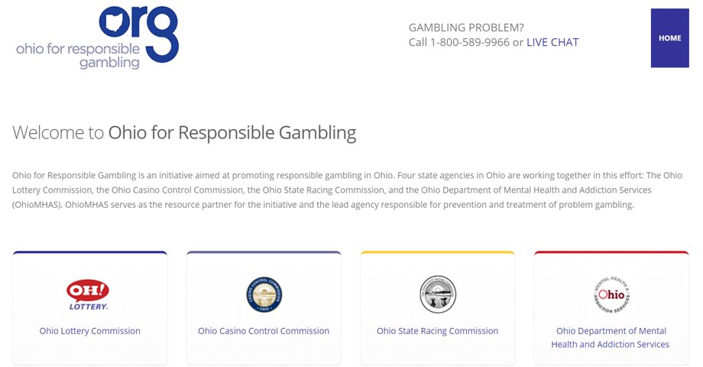
Collaboration

Slide 7
Funding
Lottery funds 10 providers, conference, training and media
Casino fund divided out to Boards for distribution, VEP
Rupcich, Helpline, PGNO, Shortfall funding, Prevention

Slide 8
Training
Stage I
Stage II
Advanced
Conference
Supervision Fellowship
PGI Integration

Slide 9
Changes
2017 Leadership change at PGNO
Training, Fellowship, Warm Transfer
Second Survey, increases in at risk individuals----double

Slide 10
Evolving
Training
PGNO
VEP
Conference in Cleveland
Involvement Nationally
‘GBIRT’

Slide 11
ORG

Slide 12
Partnerships

Slide 13
Relationships

Slide 14
Networking

Slide 15
Media

Slide 16
Ohio Proud

Slide 17
At Risk
Older adults
Adolescents
Males 18-34
Veterans
TBI/PTSD
Trauma
Medications for Parkinson’s and Restless Leg Syndrome

Slide 18
At Risk
Language
Windfall
Triggers
Escape

Slide 19
Screens
SOGS
BBGS
Volberg
Assessment

Slide 20
Incarcerated
Hustle
Violence
Gang/STG
Outside involvement
Staff
Debt
Something of value

Slide 21
Committing Offense
Theft
Embezzlement
Human Trafficking
Checks
Money Laundering
Identity Theft
Assault

Slide 22
DSM 5
A. Persistent and recurrent problematic gambling behavior
leading to clinically significant impairment or distress, as indicated by the individual exhibiting four (or more) of the
following in a 12 month period
Gamble more money in order for desired excitement
Restless or irritable when cut down or stop
Unsuccessful at control, cut back, or stopping gambling
Is often preoccupied with gambling

Slide 23
DSM 5
Often gambles when feeling distressed
Chasing
Lies
Risked or lost a significant relationship, job, or school
Bailouts to relieve a desperate financial situation
B. The gambling behavior is not better accounted for
by a Manic Episode.

Slide 24
DSM 5
Specify current severity level
Mild: 4-5 criteria
Moderate: 6-7 criteria
Severe: 8-9 criteria

Slide 25
Treatment
Motivational Interviewing
CBT
Mindfulness
Brief
Lethality

Slide 26
lethality
Among those with gambling problems:
38% suicidal ideation (SI)
32% suicide attempt
SI leads to more gambling when gambling
SI+ PG = 5x more likely to have depression
PG + Drug history = 6x more likely attempt
21% of attempters say it is gambling related
Hodgins et al, 2006

Slide 27
Cognitive distortions
“I can influence the outcome”
Blow on dice
Change machines
Watch the game (don’t want you to watch)
Skill vs. Luck
Control the uncontrollable
I have a system
Hope
Illusion of control

Slide 28
Myths
“They pump oxygen into the building”
Machines payout differently by location, time, day of the week, etc.
Machines are “due”
Odds can be changed
Lot numbers on lottery tickets
What have you heard???

Slide 29
The Landscape of Gambling in Ohio

Slide 33
Response
Toolkits in Before You Bet
Micro Campaigns
Focus Groups
Advanced opportunities

Slide 34
Timeoutohio.com

Slide 35
Helpline
1-800-589-9966
1-800-GAMBLER
Warm Transfer

Slide 36
Questions​ scott.anderson@mha.ohio.gov​ 614-466-8562​ ​ milan.karna@mha.ohio.gov​ 567-213-9723

