Slide 1
Mike DeWine, Governor
Jon Husted, Lt. Governor
Lori Criss, Director
Ohio’s Behavioral Health Priorities
Real Results for Ohioans
October 11, 2023
Director Lori Criss

Slide 2
agenda
Review of Governor Mike DeWine’s Budget Priorities
OhioMHAS Budget/Behavioral Health Highlights
Q&A

Slide 3
Governor Mike DeWine's Behavioral Health Priorities
Building a community care system that increases prevention efforts
Growing our behavioral health workforce
Offering better crisis response services and treatment options
Focusing on much-needed research and innovation

Slide 4
COMMUNITY CARE & PREVENTION
Psychiatric Residential Treatment Facilities (PRTF)
Prevention
Expanded Forensic Services
Crisis Services & Integrated Care

Slide 5
Strengthening Ohio’s Crisis System Roadmap
988 Launch​
Crisis Administrator​
ARPA Awards
Successfully launched 988, ensuring statewide coverage
$90M in Crisis Infrastructure funds available to ADAMH Boards
First agency Crisis Services Admin hired
2023
Q1
Q2
Q3
Q4
Board Crisis Assessments
Crisis Landscape
Analysis
Workforce
Roadmap
2024
Wellness Workforce and
Great Minds Fellowship Kickoff
Q4
Q3
Q2
Q1
2025
Performance
Metrics
Transportation Workgroup
Rules
Development
Crisis system performance
metrics developed
Kickoff stakeholder conversations on Crisis Rules package
Q1
Q2
Q4
2026
Q3
Two-Year Plan – SFY 2023-2024

Slide 6
PRIORITY
Provide Ohioans in crisis with an appropriate behavioral healthcare response, connect them to needed supports close to home, and reduce the burden on local law enforcement and emergency departments through:
Supporting the ongoing operations and strengthening of 988 and crisis services in Ohio.
Flexible funding to help grow Ohio’s local crisis services and infrastructure through locally identified needs and gaps that provide Ohioans with an appropriate response and safe place to have their crisis needs met.
Building 988 Suicide and Crisis Response
$86.5M across the biennium
REAL RESULTS FOR OHIOANS
Ohio’s 988 Lifeline Centers answer over 11,000 calls, chats, and texts each month from Ohioans and their families reaching out for help.

Slide 7
Crisis response & treatment
Investing in Local Crisis Services
MRSS
988
DRIVING DOWN:
ED Visits
Hospitalizations
Out of Home Placements
Arrests/Jail Stays

Slide 8
Mobile Response and Stabilization Services (MRSS)
Current:
23 organizations provide MRSS
Available in 39 counties
8 providers operate 24/7
State-wide call center operates 24/7
Last year more than 5,500 calls
PLAN TO GO STATEWIDE IN JULY 2024
Watch NewsNow for opportunities
for public comment.

Slide 9
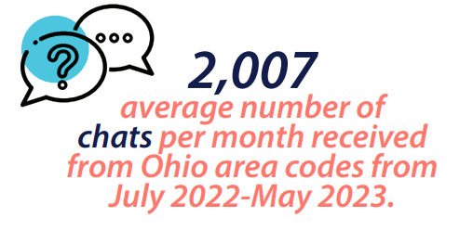
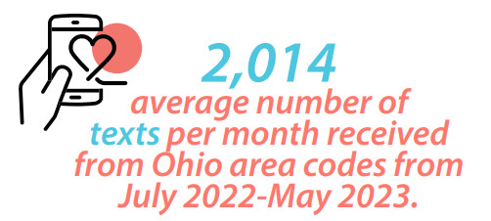
988 suicide & crisis lifeline
Expanding capacity
Helping more Ohioans
11,000 calls/chats/texts each month
Public awareness campaign

Slide 10
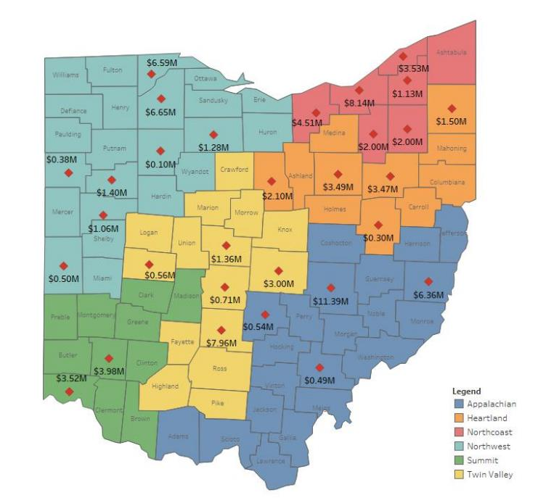
ARPA $90M Crisis Funding Impact
Over 225 new residential beds for Ohioans in crisis
5 Behavioral Health Urgent Care clinics
2 new Crisis Intervention and Observation units
6 new mobile crisis services teams
4 technology upgrade projects
2 crisis consultancy projects

Slide 11
Enhancing Pediatric Behavioral Health
$50M in one-time funds for the biennium
PRIORITY
Increase capacity for treatment for children with serious behavioral health conditions so that they can recover closer to home and Ohio can reduce out-of-home placements and out-of-state treatment transfers that families rely on today.
Build the behavioral health workforce in pediatric inpatient settings for children and youth.
Enhance residential treatment environments to create Psychiatric Residential Treatment Facilities in Ohio so that families do not have to pursue this intensive secure treatment out of state.
Support statewide expansion of MRSS.
REAL RESULTS FOR OHIOANS OhioRISE
Over 20,000 youth are enrolled in OhioRISE to receive treatment and wrap around services.
Over 4,500 children, youth, and families across the state have been helped through Mobile Response Stabilization Services.

Slide 12
PRIORITY
Promote mental health awareness and resiliency to help all Ohioans achieve their full potential through:
Prevention, early intervention, and suicide prevention priorities of Ohio’s 2020 Suicide Prevention Plan, to increase the number of Ohioans trained to recognize warning signs and promote protective factors, resiliency, and stigma-reduction, specifically for at-risk populations.
Expanding Ohio’s Student Assistance Program.
Student Wellness and Success.
Building Resiliency through Prevention and
Early Identification
$13.9M across the biennium
REAL RESULTS FOR OHIOANS
Ohio piloted a Student Assistance Program in over 70 schools across Ohio in the last biennium, and this budget will help expand this valuable prevention framework to more schools.

Slide 13
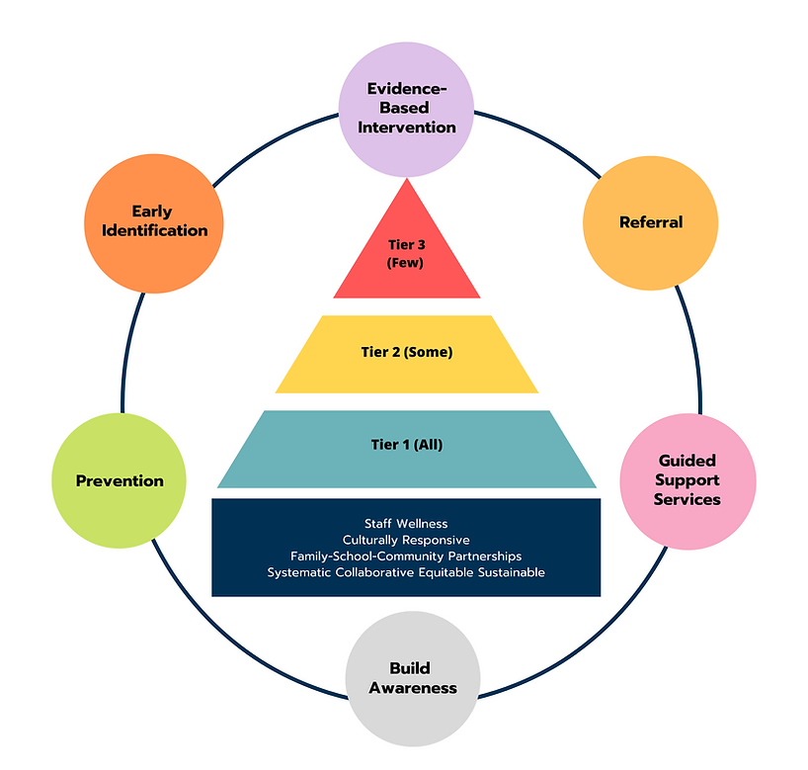
What does SAP look like in schools?
The Student Assistance Team works to connect students to resources to remove barriers to learning. SAP does not provide treatment for students but can refer students to community resources for further assessment and treatment.
​Ohio’s SAP model provides a continuum of care, including (1) awareness, (2) prevention, (3) early identification, (4) evidence-based intervention, (5) referral processes, and (6) guided support services.
​​When a concern arises and is referred to the Student Assistance Team, the team can begin identifying the concern. A team then collects and reviews objective student information as well as engages the caregiver(s) and student to learn more. With this information, the team develops a plan to remove learning barriers and use school-based and/or community-based resources. Team members follow up with the implemented plan and provide case management and monitoring.
www.ohioschoolwellnessinitiative.com/what-is-sap

Slide 14
MENTAL HEALTH RESOURCES FOR COACHES
In partnership with the Ohio Department of Education, MHAS has developed a new webpage providing coaches with a list of approved trainings currently available in the community.
Please visit: https://mha.ohio.gov/supporting-providers/training-and-resources/mental-health-training-for-odes-coaching-permits for more information.
For questions, please reach out to: MHCoachesTraining@mha.ohio.gov.

Slide 15
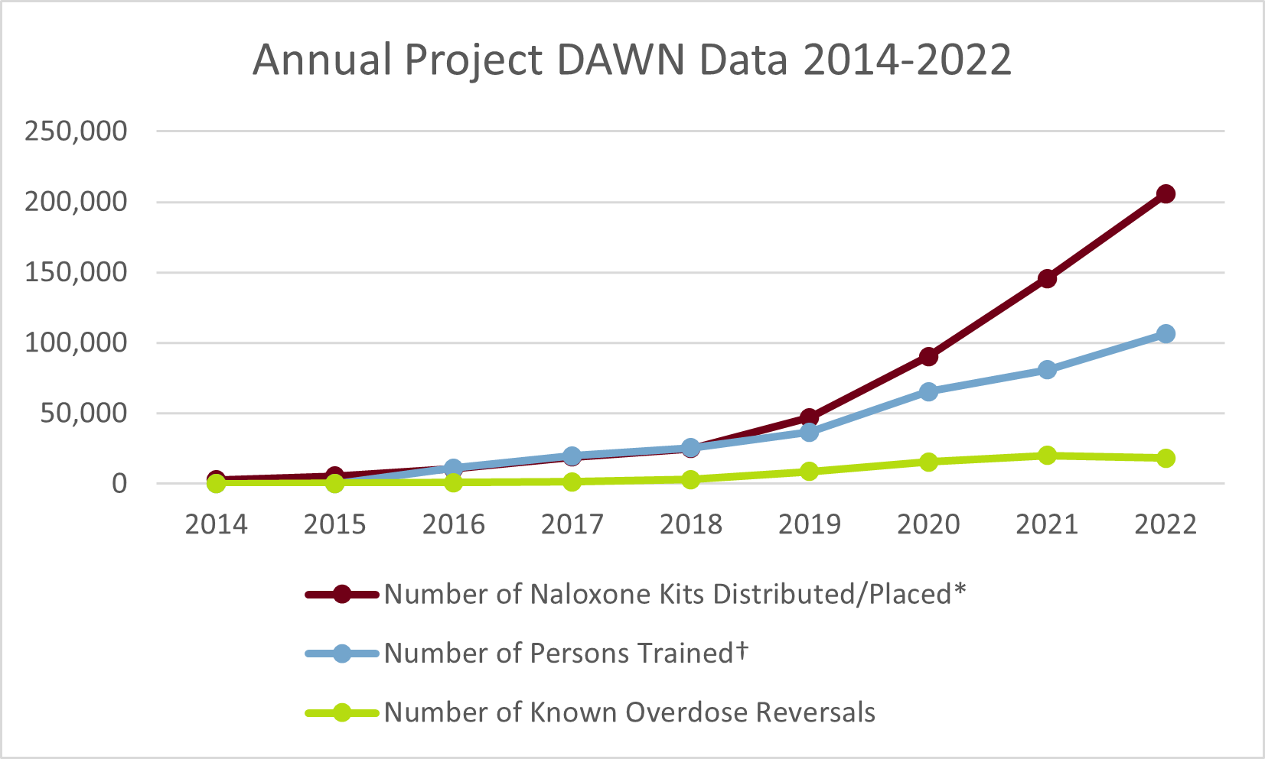
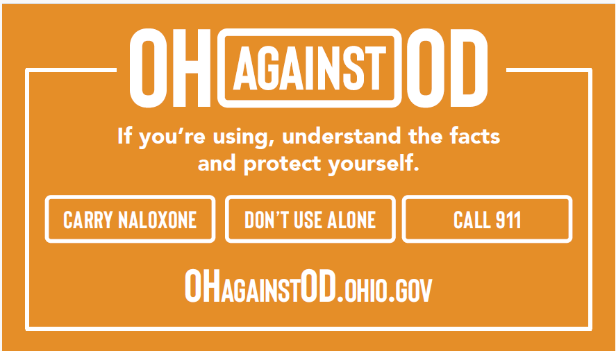
Overdose prevention
• Naloxone Distribution • Fentanyl Test Strip Distribution • OH Against OD •

Slide 16
ASAM RELEASES VERSION 4.0
New chapters in the fourth edition of The ASAM Criteria include:
Early Intervention and Secondary Prevention
Telehealth and Other Health Technologies
Integrating Recovery Support Services
Integrating Trauma-Sensitive Practices, Culturally Humble Care, and Social Determinants of Health
Addressing Pain
Addressing Cognitive Impairment
The updated continuum of care promotes:
A CHRONIC CARE MODEL OF TREATMENT, INTEGRATION OF CARE, CO-OCCURRING CARE, HARM REDUCTION and
ACCESS TO RECOVERY SUPPORT SERVICES. The fourth edition advocates for recovery-oriented systems of care by including standards for recovery support services to be available directly or through partnerships at each level of care and to promote ongoing remission monitoring and recovery management checkups for patients who have achieved sustained remission. ASAM collaborated with the National Alliance for Recovery Residences to also define criteria for recommending recovery housing in addition to an outpatient level of care.

Slide 17
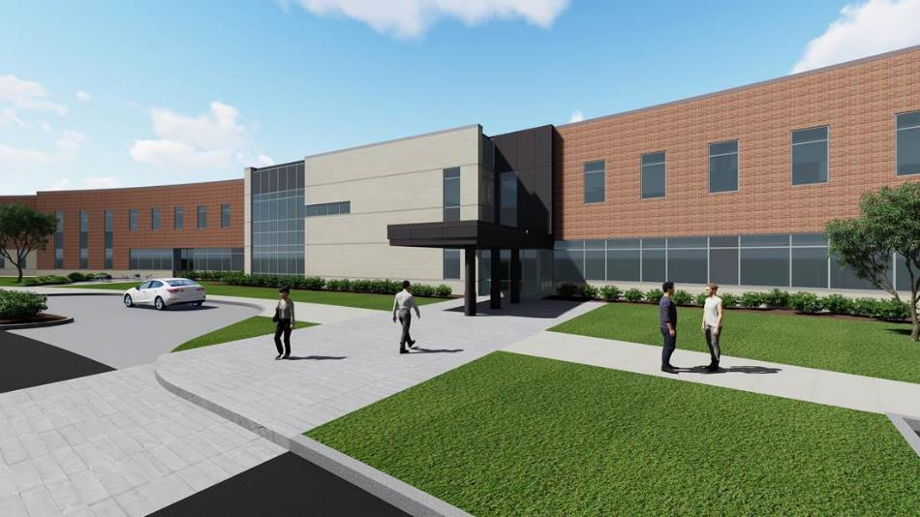
PRIORITY
Expand state hospital bed capacity, ensure hospital staff and patient safety, and alleviate stress placed on adjacent systems, such as local jails and courts, through:
Growing State Hospital capacity by 30 beds and adding staffing support.
Leveraging the availability of beds at private psychiatric hospitals for vulnerable Ohioans without coverage ($14M).
Expanding Inpatient Access for Acute Level Care
REAL RESULTS FOR OHIOANS Hospital Access Program
By leveraging available private hospital beds, over 3,400 vulnerable Ohioans have received timely access to inpatient care (as of May ‘23).

Slide 18
Expanding Jail and Forensic Services
$63.5M across the biennium
PRIORITY
Help criminal-justice involved Ohioans connect with treatment and recovery supports through:
Enhancing forensic center capacity for court-ordered evaluations and monitoring and continued support for Ohio’s specialty courts.
Improving the ability of jails to offer addiction services and psychotropic medications to help these Ohioans receive the care they need with the goal of reducing recidivism and increasing public safety.
Authorizes jail-based competency restoration.
REAL RESULTS FOR OHIOANS Specialty Courts
These courts helped over 7,400 Ohioans, resulting in a 3% recidivism rate at Ohio’s prisons and 1% rate at juvenile facilities (as compared to 21% and 33% respectively in FY22).

Slide 19
Growing Wellness and Recovery Supports $21.5M across the biennium
PRIORITY
Continue to grow coordinated community treatment and recovery supports for Ohioans living with mental illness and substance use disorders, with the goal of achieving wellness and reducing costly hospital admissions and jail stays.
Continued funding for Adult Access to Wellness project (formerly Multi-System Adults) to connect these Ohioans with needed resources like housing, transportation, medication, and employment supports.
Expanded funding for Peer Recovery Organizations, Clubhouses, and youth peer supports across Ohio.
REAL RESULTS FOR OHIOANS Adult Access to Wellness
72% of participants were not re-hospitalized and 88% were not re-incarcerated (FY22).

Slide 20
Increasing Housing Options and Enhancing Quality
$64.5M across the biennium
PRIORITY
Support quality housing options for Ohioans living with and recovering from mental health and substance use disorders by:
Increasing the Residential State Supplement ($48M).
Growing quality Recovery Housing across the state.
Continued support for community transition programs to help people with mental illness and substance use disorders successfully reenter their community upon release from Ohio’s adult prison system.
REAL RESULTS FOR OHIOANS
Community Transition/Linkage Programs
Over 15,000 Ohioans in 57 counties received transition support services (FY 22).

Slide 22
Ohio Vision for Integrated Behavioral Healthcare
OhioMHAS established a vision for the integration of care between mental illness and substance use disorders that emphasizes accessibility of services and cultural competence.
Ohio’s Integrated Care for Mental Illness & Substance Use Disorder
Your Care. In Your Community. In Your Hands.
Ohio’s behavioral health system will deliver better access, better treatment, better outcomes, and better experience of care for Ohioans of all ages. Those in need of services and their families will feel welcomed, valued, and will increase understanding and personal ownership of their behavioral healthcare, recovery, and wellness.
Ohio’s behavioral health system will serve as a model where Ohioans thrive and live up to their full potential regardless of where they live.
Integrated mental health and substance use disorder services will be responsive and delivered in a high quality and easily accessible system of care that is holistic and culturally informed, making those in need of services feel welcomed and valued.

Slide 23
What is a Certified Community Behavioral Health Clinic (CCBHC)?
CCBHCs provide:
COORDINATED CARE
Comprehensive, coordinated mental health and substance use services appropriate for individuals across the life span
EVIDENCE-BASED PRACTICE
A range of evidence-based practice, services, and supports to meet the needs of their communities
ACCESSIBILITY
Increased access to high-quality community mental health and substance use care, including crisis care
EQUITABLE SERVICE
Service to anyone seeking help for a mental health or substance use condition, regardless of their diagnosis, place of residence, or ability to pay
PERSON-CENTERED CARE
Integrated person- and family-centered services, driven by the needs and preference of people receiving services and their families
Source: Certified Community Behavioral Health Clinics (CCBHCs)
SAMHSA, 24 Apr. 2023, www.samhsa.gov/certified-community-behavioral-health-clinics.

Slide 24
GOALS OF THE CCBHC INITIATIVE FOR OHIO
Ohio CCBHC Goals
Advance the patient healthcare experience through ease of access to quality, comprehensive outpatient behavioral health services, including crisis services, that are reflective of and responsive to the population being served.
Empower individuals and families to direct their behavioral health care through patient centered care planning to promote resilience and self-efficacy.
Incorporate equitable, culturally informed evidence-based practices that are tailored to the individual, and the identified and evolving needs of the CCBHC population.
Leverage care coordination as a linchpin for service delivery.
Promote prevention and recovery while fostering resilience and addressing social determinants of health.

Slide 25
Ohio CCBHC Planning Grant Period
Ohio is a unique state consisting of urban, rural, and Appalachian areas. Each of these areas will likely require customization of the CCBHC model for the populations and geography covered. CCBHCs will also need to be designed to address health inequities across the board.
Purpose
Approach
The purpose of this one-year planning period is to develop OhioMHAS regulatory framework for certification of CCBHCs and develop an application to participate in a four-year CCBHC Medicaid Demonstration.
Ohio’s approach to planning for the demonstration will include a strategic and selective process designed to test the CCBHC model(s). The state intends to select one provider for each of three areas; urban, rural and Appalachian.
Specifications

Slide 26
CCBHC Planning Grant Period Timeline
WE ARE HERE
Grant Award
Planning Grant
Demonstration Application
March 2023
As part of the planning process, Ohio will develop a future CCBHC Demonstration timeline that considers time needed to make regulatory and systems changes as well as planning for operational activities necessary to support providers for a successful future implementation.
March 2024 or later
Under the leadership of Directors Criss (OhioMHAS) and Corcoran (ODM) Ohio was one of 15 states awarded a $1 million, one-year CCBHC federal planning grant from SAMHSA.
The culmination of the planning grant is preparation of an application to participate in a four-year CCBHC Demonstration.
While the planning grant is available for a one-year period, additional activities may extend beyond the planning grant period.

Slide 27
GROWING OHIO’S WELLNESS WORKFORCE
Release of workforce roadmap
Great Minds Fellowship
Medicaid changes to support peer supporters in behavioral health settings
For more information, please visit: https://mha.ohio.gov/about-us/priorities/workforce

Slide 28
PRIORITY
In conjunction with federal funding allocated for workforce initiatives, the MHAS budget contains funding to support the recruitment, retention, and contemporary practice needs of BH professionals through:
Increased rates for behavioral health providers.
Continued support for Ohio’s Centers of Excellence and a Technical Assistance Center to provide educational and training opportunities around evidence-based best practices, data sharing, and learning collaboratives.
Building the behavioral health workforce in pediatric inpatient and residential settings for children and youth.
Growing a Strong and Supported Workforce
REAL RESULTS FOR OHIOANS Growing Ohio’s Peer Specialist Network
Ohio now offers three types of Peer Supporter certifications, and nearly 6,000 Ohioans have successfully completed Peer Supporter training.

Slide 29
Ohio’s Behavioral Health System Workforce Strategy Development – Final Roadmap
PROJECT OVERVIEW
PHASE 2
Ohio’s Department of Mental Health and Addiction Services (OhioMHAS) is committed to enhancing the Behavioral Health (BH) Workforce in Ohio through the implementation of a four phased project that aims to define strategies to address the key challenges within four Wellness Workforce Priorities.
Based on key findings from Phase 1 (“Behavioral Health Workforce Supply and Demand Report”), the goal in Phase 2 was to develop Ohio’s BH Workforce Roadmap outlining an implementation plan for initiatives that include cultural competency considerations. Phase 2 Approach:
1. Collected qualitative data from 4 focus groups, 27 individual interviews, and a
widely distributed survey (2,000+ responses)
2. Convened a Bi-Weekly Advisory Council to brainstorm, prioritize, and provide
feedback
3. Summarized 79 key initiatives within 10 solution categories and presented in the
Synthesis Report
Wellness Workforce Priorities
Increasing Career Awareness
Supporting Recruitment
Supporting Contemporary Practice
Incentivizing Retention
The Advisory Council prioritized 22 Initiatives and sequenced them across 4 years.
Next Steps
CULTURAL COMPETENCY CONSIDERATIONS
Roles & Responsibilities Identify initiative owners, project participants, SMEs & Stakeholders and define their roles and responsibilities (including meeting cadence and communication methods)
It is crucial to ask the following when undertaking new initiative to promote cultural competency:
Owners & Stakeholders
Whose voices and experiences are being prioritized when making decisions? How can more voices be included?
Reporting Mechanism Create initiative-specific templates for providing regular status updates, tracking decisions, risks, and issues and establish mechanism to track funding (need & spend)
Who will feel the disproportionate impact of these decisions? Are they included in the decision-making process?​
Reporting
What additional training or information related to cultural competence would be advantageous?
What advancements have been made to ensure diverse representation & entry for marginalized communities?
Project Plan
Project Plan Create initiative-specific project plans defining required level of effort, milestones, key performance indicators, tasks, dependencies, durations, and start and end dates
What foundational cultural competence is necessary for all stakeholders to have to ensure equitable delivery?​

Slide 30
great minds fellowship
Students at two and four-year colleges and universities eligible for up to $10,000
Eligible for up to $5,000 post graduation
CBHC funding available

Slide 31
Expanding peer support
Additional certifications:
Peer, Youth, Family
Adding MH Peer Support to Medicaid benefit in 2024
Streamlined certification process

Slide 32
Welcome back campaign
Incentivizing behavioral health professionals to return to the workforce
Campaign launching soon

Slide 33
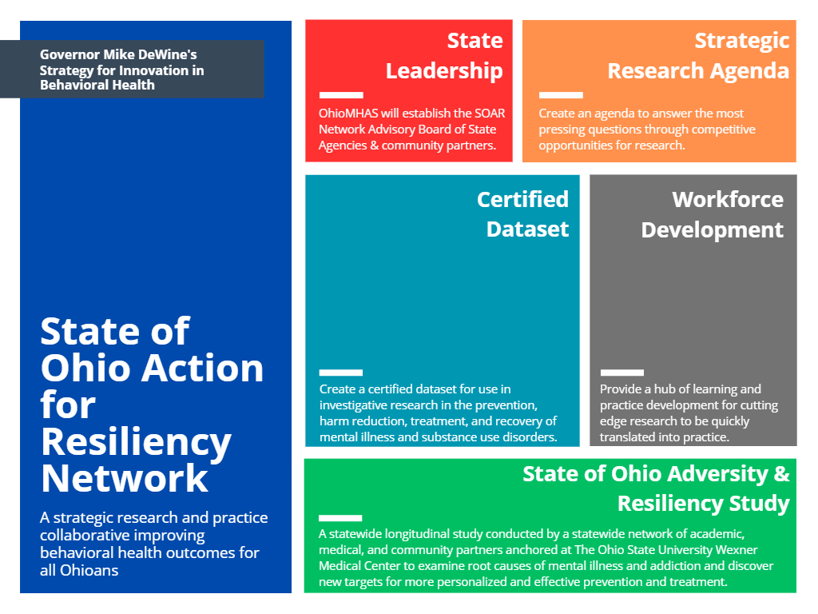
Kickstarting Innovation and Research for Wellness and Recovery
($30M)

Slide 34
Research & innovation
Data Modernization Project
Innovation Assessment Workgroup
SOAR Network
SOAR Study
Better access.
Better experience of care.
Better outcomes.
Who’s getting left behind?

Slide 35
Data modernization
Improving the data we collect and how we use it
Annual Data Brief
Dashboards
Next data forum in January 2024 – stay tuned to NewsNow for more updates

Slide 36
Key Policy Initiatives
Promote the safety and wellbeing of people served by OhioMHAS regulated hospitals, providers, and residential facilities.
Providing flexibility to counties through cash management authority and combination of psychotropic and addiction medication reimbursement programs.
Ensuring the quality of Recovery Housing through enhanced accreditation standards.

Slide 37
New Provider: Community Mental Health Services Provider
Who is Impacted
Statutory Requirement
ORC 5119.35 - Community Mental Health Services Providers
A community mental health services provider will be required to be certified
This statutory change aligns the requirements for community mental health services providers with the current requirements for community addiction services providers. Collectively, the two provider types are identified as “community behavioral health services providers.”

Slide 38
New Provider: National Accreditation
Who is Impacted
Statutory Requirement
ORC 5119.36 - Community Behavioral Health Services Providers
A community behavioral health services provider must be accredited by one or more of the following national accrediting organizations:
TJC
CARF
COA
Or other national accrediting body that the OhioMHAS Director considers appropriate

Slide 39
Current Provider: National Accreditation
Who is Impacted
Statutory Requirement
ORC 5119.36 - Community Behavioral Health Services Providers
At the first renewal, on or after October 1, 2025, a community behavioral health services provider who is currently OhioMHAS certified will need to hold national accreditation

Slide 40
Requirements Effective October 3, 2023
New Provider Requirements
New Provider (definition) – a provider who applies for licensure or certification on or after October 3, 2023, or a provider who does not hold OhioMHAS licensure or certification prior to October 3, 2023
Current Provider Requirements
Current Provider (definition) – a provider who has submitted an application for licensure/certification prior to October 3, 2023, or a provider who currently holds OhioMHAS licensure or certification prior to Oct. 3, 2023

Slide 41
Certified Services
National Accreditation Required | National Accreditation Optional | Ohio Specific Service OhioMHAS will not recognize National Accreditation | Under Department Review
General services | Prevention | Forensic Evaluation | Driver Intervention Program
Mental health day treatment |  | Consultation | Mobile Response & Stabilization Service
Behavioral health hotline |  | Referral & Information | Peer Recovery Services
Residential and withdrawal management, substance use disorder services |  | Supplemental Behavioral Health | Peer Run Organization
Crisis intervention
Employment service
SUD case management
Community psychiatric supportive treatment
Therapeutic behavioral services & psychosocial rehabilitation
Intensive home-based treatment
Assertive community treatment
SUD, Qualified residential treatment program (QRTP) for youth*
Qualified Residential Treatment Program*
*NOTE: Program must hold youth residential national accreditation

Slide 42
Community Behavioral Health Services Certification Exemptions
Current exemptions from the statutory certification requirement include:
An individual who holds a license, certificate, or registration issued by an Ohio professional licensing agency authorizing the practice of a health care profession that includes the performance of any OhioMHAS certifiable service, regardless of whether the service is performed as part of a sole proprietorship, partnership, or group practice.
An individual who provides any service that is required to be certified as described in ORC 5119.35 as part of an employment or contractual relationship with a hospital outpatient clinic that is accredited by an accreditation agency or organization approved by the OhioMHAS Director.

Slide 43
More Accreditation Information
Next Accreditation webinar is scheduled for tomorrow - Thursday, October 12th, at 10:00 a.m.
Questions? Email LicCert@mha.ohio.gov

Slide 44
BUDGET CHANGES TO O.R.C. SECTION 340
Ensures that, when there is a withdrawal from a joint-county district, county commissioners will submit a comprehensive plan for withdrawal
Permits ADAMH Boards to have 18, 15, 14, 12, or 9 members
Expands the appointment authority of Boards of county commissioners to two-thirds of ADAMH Board seats, and reduces the appointment authority of the OhioMHAS Director or one-third of ADAMH Board seats
Allows the appointing authority to remove an ADAMH Board member at will
Boards may provide input and recommendations to OhioMHAS when an application or renewal of certification has been submitted
Adds faith-based organizations to the list of entities with which ADAMH Boards may contract
Clarifies that the current authority of an ADAMH Board to remove its executive director for cause applies at any time
Requires each ADAMH Board to annually update and publish a list of all licensed opioid treatment programs operating within the Board's district
Eliminates obsolete provisions describing past local and statewide reports
Note: These provisions reflect sections of SB 105 that was introduced
outside of the Department’s 340 Review Workgroup.

Slide 45
Other Behavioral Health Highlights from Across the Administration
Ohio Department of Education
Student Wellness and Success (Enhanced accountability; BH wellness coordinators) MH training for athletic coaches
Ohio Department of Higher Education
Continuation of Funding for Mental Health Supports
New Department of Children and Youth
Social Media Parental Notification Act

Slide 46
If someone you know needs support now, call or text 988 or chat 988lifeline.org

Slide 47
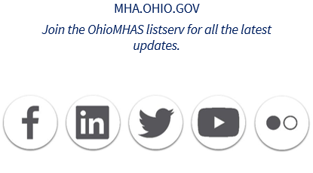
Questions?

