Slide 1
Inspiring Change: People. Practice. Policy. The Ohio Council of Behavioral Health Annual Meeting October 10, 2023
Maureen Corcoran, Ohio Department of Medicaid

Slide 2
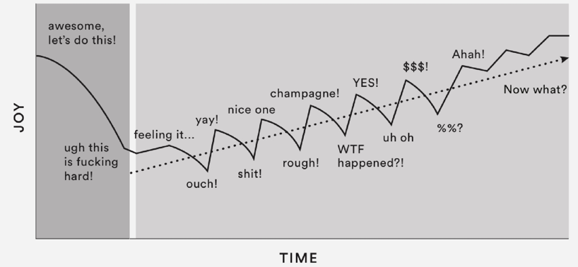

Slide 3
BUDGET AND OTHER BH RELATED POLICY

Slide 4
The best place to live, work, raise a family, and start a business.
HB 33 SFY 24-25 Budget

Slide 5
ODM Strategic Priorities for the SFY 24-25 Budget
Ensuring eligible Ohioans have continuous access to high-quality health care as the state resumes routine eligibility operations.
Preserving and strengthening access for Ohioans to behavioral health and other community-based services, focusing on those who provide direct care and services to individuals while working to address workforce shortages.
Continued implementation of Medicaid’s Next Generation of managed care, including OhioRISE, the Single Pharmacy Benefit Manager (SPBM), Fiscal Intermediary (FI), and the Provider Network Management (PNM) module.
Ensuring Ohio’s mothers and children have access to the necessary programming for sustainable healthcare they need, connecting pregnant mothers to evidence-based resources that improve birth outcomes, seeking to eliminate disparities that negatively impact the health of Ohioans we serve.
Continuing progress on priority policy initiatives approved in HB 110 of the 134th General Assembly.

Slide 6
Community Behavioral Health: Update
Target effective date January 1, 2024
State Plan | The following rate increases have been included to address the workforce pressures:
We are increasing BH Services 12.75%; 10% increase for medical services in community BH agencies
The BH rates “clearance” posting has expired but glad to continue to take feedback.
We have posted the federal Medicaid notice re: SPA of our intent to raise rates.
On track to “original file” these rules with JCARR later this month
NEW Mental Health Peer Support Service
Anticipate policy and rule work to be completed by April 2024; need to evaluate IT changes and timeline.
Build on the OhioMHAS enhanced peer support rules to establish Medicaid policy and reimbursement. This will require clinical/programmatic work, along with reimbursement considerations.
Separate funding dedicated for this service.

Slide 7
Other ODM Budget Provisions
Specifications regarding training and supervision of ODM/ODA waiver personal care aides.
Other rate increases of note: Emergency transportation and Dental.
New department of Children and Youth.
Adoption, child-care, early childhood, maternal and infant mortality.
Makes continuous Medicaid coverage available for children ages 0-3
Continued implementation of ODM’s Maternal and Infant Support Program (mom/baby dyad care, doulas, lactation consultants, postpartum nurse home visits) and Healthy Beginnings at Home.
Expansion of Medicaid school program.
Medicaid Buy-In for Workers with Disabilities > 65 years old
Meaningful employment.
Next Generation work collaborative - JFS/ODM.
Community work orgs, MCOs.

Slide 8
In Ohio, our people are our greatest asset. That is why this budget for fiscal years 2024-2025 invests in Ohioans, in our communities, and in our thriving economy.
Governor Mike DeWine
ODM Budget Website
https://medicaid.ohio.gov/about-us/budget
July webinar for stakeholders
H.B. 33 - HCBS SFY 24/25 Budget Tracker
Additional info re: rates, rules, white papers

Slide 9
Unwinding

Slide 10
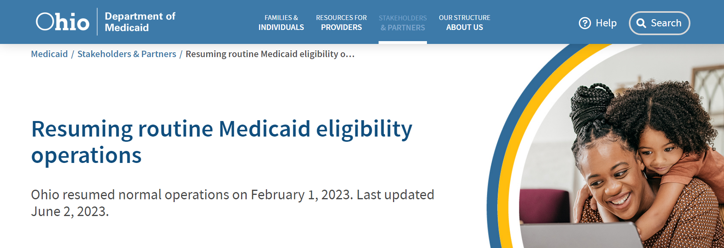
Notes:
Speaker’s Notes: Patrick Beatty

Slide 11
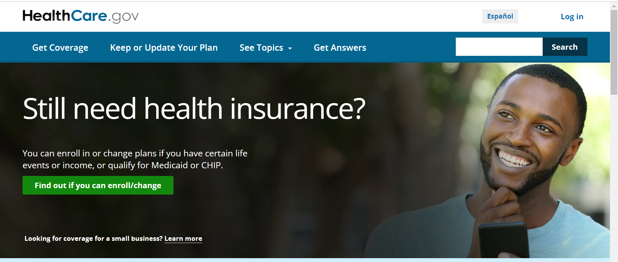
Other Coverage Options When Individuals are No Longer Eligible
If a Medicaid member has been notified they no longer qualify for Medicaid, they may be eligible for other coverage options either through their employer or on the federally facilitated marketplace (i.e., exchange).
OB makes automatic file transfers through the exchange for individuals found ineligible (not individuals disenrolled for procedural reasons)
ODM partnered with the Ohio Association of Foodbanks to include information on every notice of disenrollment (otherwise known as a Notice of Action) for those individuals who need assistance with other coverage options. They can visit getcoveredohio.org or call 1-888-628-4467 for help in person, online or over the phone.
Notes:
Speaker’s Notes: Patrick Beatty

Slide 12
Resuming Routine Eligibility Operations: Appendix K Flexibilities
Throughout its work on Appendix K, the State has sought to engage stakeholders at each step of the process via webinars, communications notices, public comment periods, and other channels.
Learn more and find updates on the progress of ODM’s Appendix K work at
https://medicaid.ohio.gov/stakeholders-and-partners/covidunwinding
Subscribe to the Home- and Community-Based Waiver Programs newsletter at
https://medicaid.ohio.gov/home/govdelivery-subscribe
For flexibilities that will end, the agencies will develop and communicate transition plans to ensure minimal impact on individuals.
12
Notes:
Speaker’s Notes: Patrick Beatty

Slide 13
Telehealth Appendix K
Appendix K
Case Management Emergency Protocol: Response to COVID-19
Allowed for required in-person assessment and visits to be performed via telehealth.
Ohio Administrative Code (OAC) rules have been updated to reflect ongoing eligibility, provider certification, and service rule changes for each program.
Beginning January 1, 2024, all assessments will go back to in-person
CMS granted 6 months after the end of the PHE to resume normal operations and an additional month by waiver.
ODM and ODA anticipate in-person visits to resume in a phased approach with the goal for all individuals to have an in-person visit/assessment completed no later than six months from the end of the Federal Public Health Emergency.
Case Management Agencies will offer the assessment in-person and will accept a telehealth request through December 31, 2023.
There are no other changes to telehealth services
OAC 5160-1-18 last updated July 15, 2022.
13

Slide 14
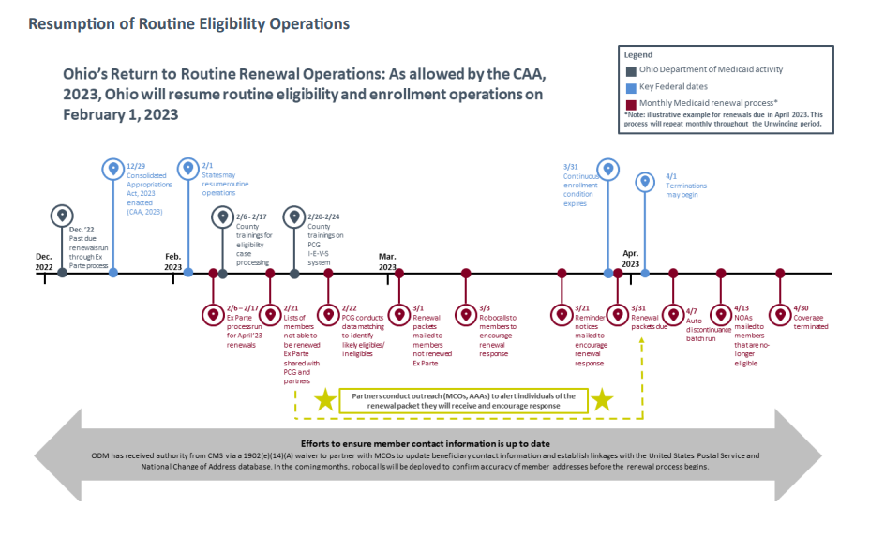
Key Notes & Dates
April 2023 was the first month of renewal due dates that states were permitted to begin routine eligibility determinations
Ohio’s ex parte (aka passive renewal) runs two months prior to due dates
To date, the renewals for over 2 million recipients have been initiated.

Slide 15
Ohio experience thru September 2023
Ohio thru July:
# of Individuals & % ages | April | May | June | July | August | September
Total up for renewal | 283K | 316K | 318K | 320K | 294K | 298K
# Retained on Medicaid | 209K | 232K | 216K | 216K | 193K | 195K
% Retained of month total | 74% | 73% | 68% | 68% | 66% | 65%
% People terminated | 24% | 23% | 23% | 24% | 26% | 24%
% People ineligible | 8% | 7% | 6% | 5% | 6% | 5%
% Procedural terminations | 16% | 16% | 17% | 19% | 20% | 19%
Not processed by month end | 2% | 4% | 9% | 8% | 8% | 10%

Slide 16
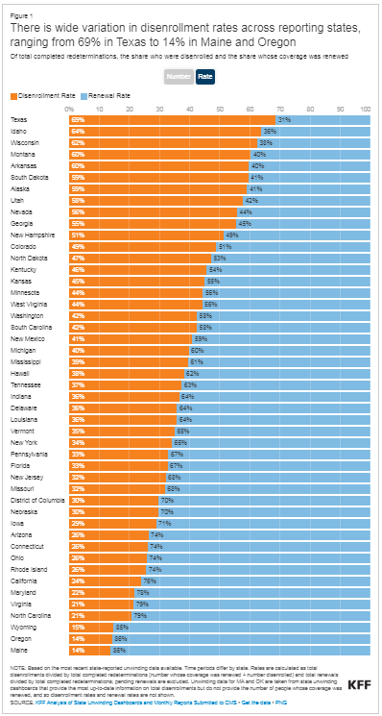
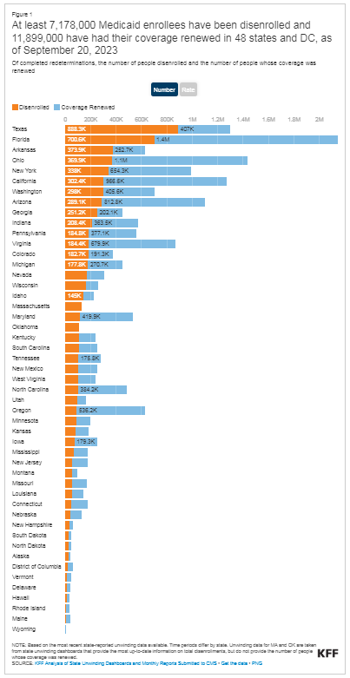
KFF Multi state disenrollment rates

Slide 17
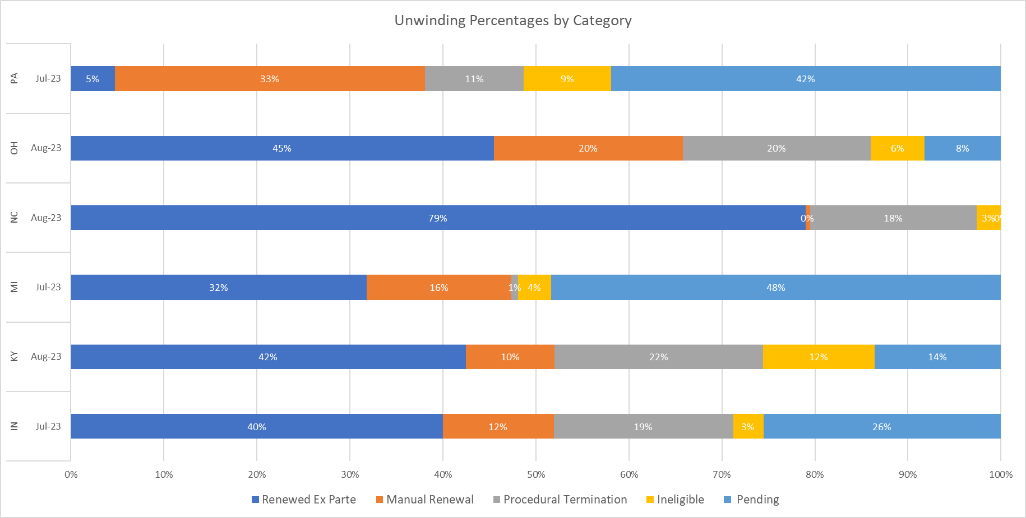
Peer State Comparisons
PA
OH
NC
MI
KY
IN
Renew ExParte Manual Renew ProcTerm Ineligible Pending

Slide 18
Ohio Department of Medicaid Eligibility PROCESS: END-TO-END
Example: July 2023 renewals
Auto Ex Parte
40%
Ineligible Terminations
5%
Eligibility process data highlights
50% of procedural terminations were found “likely ineligible”
Approximately half of cases categorized as "prepopulated form" renewals are manual ex parte renewals conducted without a prepopulated renewal form returned
Procedural Terminations ¹
19%
Manual Ex Parte/Pre-Populated Renewal Forms ²
28%
Communications
IVR: automated reminder calls to members
ProComm: state automated reminder texts to members & updates member addresses in Ohio Benefits
CMA/MCO outreach to members
3rd party
data sources reviewed
IEVS analyzes & sorts fallout cases
Cases identified as eligible, likely eligible, likely ineligible
Eligible: Renewal
Received Bot engaged &
caseworker attempts
manual ex parte
Likely Eligible &
Likely Ineligible:
Renewal Packets Sent
Automations throughout eligibility process
Fast Lane Bot: conducts nightly sweeps to identify any SNAP re-certifications with a corresponding Medicaid case (e14 SNAP option waiver authority)
Address Bot: automates address updates received from MCEs, Automated Health Systems, and received through National Change of Address database (e14 waiver authority) in Ohio Benefits System
*NOTE: the remaining 8% are cases that were
not yet processed at the time of reporting

Slide 19
Next Generation

Slide 20
Next Gen Update & Other ODM BH Policy
Population Health & Next Generation Changes
Inc. changes to care coordination
CPC, CPC-Kids, CMC
APM & Other value based relationships
(beginning Dec.23 to count for SFY24)
CCBHC & associated service/coding refinements
MRSS & crisis continuum

Slide 21
Ohio’s Next Generation Medicaid Program Mission Statement

Slide 22
Next Generation Ohio Medicaid Implementation
launched to help children and youth with behavioral health and multi-system needs.
Centralized Provider Credentialing
reduces duplication,
providers have more time for members.
Single Pharmacy Benefit Manager (SPBM) statewide pharmacy access for members,
statewide payment policies for pharmacies.
1
July 1, 2022
2
October 1, 2022
Next Generation Managed Care Plans
Individualized assistance and coordination for members, focus on quality and outcomes.
Significant IT Systems Implementation
Intake and route majority of claims to appropriate managed care plans, increasing transparency and visibility regarding care and services.
Final IT Systems Implementation
Single point of entry for all claims and prior authorization requests.
All data transparently available for ODM to monitor and evaluate our program.
3
February 1, 2023
Gradual Completion
4
22

Slide 23
Next Generation Program Key Improvements
Better Services for Pregnant Members and Newborns
Support groups and nurse home visits for emotional and physical support during pregnancy. Free breast pump 24/7 help with breastfeeding for newborns.
After-Hours Behavioral Health Crisis Services
Access to an after-hours phone number connecting individuals experiencing mental health/addiction-related challenges to a statewide crisis line.
Enhanced Support for Member Transportation
Improved trips to appointments and pharmacies include ambulance, wheelchair van, and other emergency transportation and county non-emergency transportation.
Community Investment
Ohio Medicaid is investing in local communities by partnering with community organizations and supporting local programs to help improve health outcomes.
24/7 Medical Advice Line
Call your managed care plan’s 24/7 medical advice line anytime you have a medical question or need help.
OhioRISE
OhioRISE is a specialized managed care program for children and youth with complex behavioral health and multisystem needs.
Additional Support for Children
Additional behavioral health services include therapy and substance use disorder treatment services.
Single Pharmacy Benefit Manager (SPBM)
With Gainwell as the Next Generation’s single administrator for pharmacy needs and services, members receive medications they need regardless of managed care plan.
Commitment to Individual’s Health and Cultural Respect
We are supporting healthcare staff by providing programs and trainings that include cultural understanding and respect for everyone’s experiences.
Increased Accessibility
If English is not your primary language or you are hard of hearing, your plan has a toll-free number and telephone services available to make sure you can easily get the information and services you need.
Individualized Coordination and Care Management
Access to a health navigator to help individuals find services specific to their needs.
Freeing Up Providers to Better Serve You
Ohio Medicaid has implemented changes to ease the administrative burden on providers, so they have more time to focus on you.
Focus on Preventive Care and Wellness
Members have an opportunity to receive rewards for wellness visits, vaccinations, and preventative care screenings for illnesses including diabetes.
Telehealth Services
To ensure you can receive care even when you can’t make it to the doctor’s office, telehealth appointments are available for healthcare needs.

Slide 24
Ohio Medicaid’s Next Generation Managed Care Entities (MCE)
Serving Members since February 1, 2023
Serving Members since 2022
CareSource Ohio, Inc.
AmeriHealth Caritas Ohio, Inc.
Buckeye Health Plan
Since July 1, 2022
Humana Healthy Horizons in Ohio
Single Pharmacy Benefit Manager (SPBM)
Molina Healthcare of Ohio, Inc.
Gainwell Technologies
Anthem Blue Cross and Blue Shield
Since October 1, 2022
United Healthcare Community Plan of Ohio, Inc.
24

Slide 25
Next Generation Managed Care Plan Provider Impacts
1
2
3
Next Generation Managed Care Plans
Seven Next Generation managed care organizations (MCO) began providing services to Ohio Medicaid members.
Managed Care Contracts
Contracts with the MCOs have been updated to ensure consistency and minimize differences between how providers interact with the Next Generation managed care plans.
Managed Care Plan Portal
Continue using managed care plan portals for direct data entry of claims submission and prior authorizations (PA). All managed care PAs are submitted directly to MCO.
4
5
6
7
Member ID Number
For managed care claims submitted to a trading partner the Medicaid ID (or MMIS ID) must be the ID number used for claims processing. Providers can check member eligibility and member IDs via the Provider Network Management (PNM) module, which redirects to MITS.
External Medical Review
An external medical review is offered to providers who are unsatisfied with an MCO’s, including the OhioRISE plan, decision to deny, limit, reduce, suspend, or terminate a covered service for lack of medical necessity.
Electronic Data Interchange (EDI) Providers should confirm their trading partner is authorized to work with Deloitte, the new EDI vendor. EDI claims are submitted to the new EDI vendor. PAs will not be submitted to the new EDI.
Rendering Provider EDI-submitted claims must only include one rendering provider. Different rendering providers at the detail level are no longer acceptable.
*Exceptions for FFS Federally Qualified Health Centers (FQHC) and Rural Health Clinics (RHC) providers are detailed https://medicaid.ohio.gov/static/About+Us/PoliciesGuidelines/MAL/MAL622-A.pdf

Slide 26
OhioRISE
Notes:
Speaker’s Notes: Dawn Puster
Next, we will discuss the OhioRISE program

Slide 27
One-pager
Press Release
On July 1, 2022, Governor Mike DeWine announced the Ohio Department of Medicaid’s launch of OhioRISE (Resilience through Integrated Systems and Excellence),
Ohio’s first-ever highly specialized behavioral health program for children and youth with the most complex behavioral health needs
who are served by Medicaid.
OhioRISE Launch Updates
Resources for Members and Families
Resources for Community Partners and Providers

Slide 28
Summary of OhioRISE Objectives Improve design, delivery, and timeliness of care coordination and supports kids need to thrive
Prevent custody relinquishment and better serve multisystem youth
Add more intensive in-home and community-based services and supports
Family and youth are at the center, with voice and choice prioritized
Stakeholder engagement, transparency, and accountability
Shared governance model

Slide 29
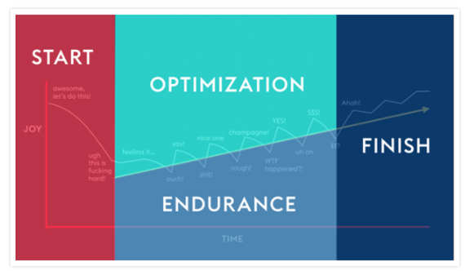

Slide 30
Ohio Medicaid Enterprise System (OMES)
Electronic Data Interchange (EDI)/ Fiscal Intermediary (FI)
Single Pharmacy Benefit Manager (SPBM)
Provider Network Management (PNM)

Slide 31
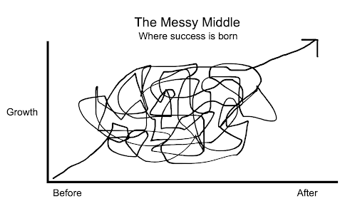

Slide 32
Ohio Medicaid Enterprise System (OMES)
Once complete, how does OMES benefit Ohio Medicaid providers?
Creates a single credentialing process through the Provider Network Module and Centralized Credentialing, rather than providers credentialing separately for each managed care entity (MCE) with which they contract.
How is OMES related to the Next Generation of Ohio Medicaid?
OMES provides new modules for conducting business and streamlines processes.
Provides pharmacy services across all MCEs and members through the Single Pharmacy Benefit Manager (SPBM).
Minimizes missing claims, delays in claims submission, and delayed payments.
Makes the claims, prior authorization, and member eligibility request process more transparent and efficient by limiting submission and communication of status to one single portal regardless of the MCE involved. Paper submissions, fax, and/or submissions to multiple MCE portals are no longer allowed.
Enables increased ODM oversight of MCEs and ability to identify and address trends by providing ODM with consistent access to claims and prior authorization request data.
Notes:
Speaker’s Notes:
OMES provides new models and systems for conducting business in the Next Generation program. This benefits providers because it:
Creates a single credentialing process through the Provider Network Module and Centralized Credentialing, rather than providers credentialing separately for each managed care entity (MCE) with which they contract.
Minimizes claims, delays in claims submission, and delayed payments.
Makes the claims, prior authorization, and member eligibility request process more transparent and efficient by limiting submission and communication of status to one single portal regardless of the MCE involved in the future. Paper submissions, fax, and/or submissions to multiple MCE portals are no longer allowed.
Enables an increased ODM oversight of MCEs and ability to identify and address trends by providing ODM with consistent access to claims and prior authorization request data.
Provided pharmacy services across all MCEs and members through the Single Pharmacy Benefit Manager (SPBM).

Slide 33
Top things Providers need to know for EDI claims*
Claims with dates of service on or after February 1 must be submitted through the new EDI vendor, Deloitte. Claims with dates of service prior to February 1 can be submitted via the current processes or the new EDI.
Separate files must be submitted using the receiver ID assigned by ODM for each plan. (e.g., CareSource Payer – file can only contain claims for members covered by CareSource)
1
5
2
Claims must include the internal managed care payer ID listed in the ODM Companion guides so the managed care entity (MCE) can route claims appropriately within their own systems.
6
Billing providers must be enrolled with ODM as a provider type who is permitted to be a billing provider and be paid for services.
Different rendering providers at the detail level are no longer acceptable for FFS and managed care claims. Claims must only include one rendering provider at the header level per claim for FFS and managed care members. The rendering provider must not be included at the detail level.**
3
7
Non-billing provider types must be affiliated with the billing provider on the claim. Claims without appropriate affiliation will be rejected on the 824 transaction.
4
Upon claim submission EDI will validate code sets. Claims with invalid codes will be rejected with the -999 transaction.
8
Must use the 12-digit ODM assigned Medicaid member ID even if an MCE is the destination payer.
Only ODM authorized Trading Partners will be permitted to exchange EDI transactions.
Companion Guides which will be used for both managed care and FFS can be found at https://medicaid.ohio.gov/resources-for-providers/billing/trading-partners/companion-guides/companion-guides.
*Providers continue to submit MyCare claims and prior authorizations to the MyCare managed care plans.
**Exceptions for FFS Federally Qualified Health Centers (FQHC) and Rural Health Clinics (RHC) providers are detailed https://medicaid.ohio.gov/static/About+Us/PoliciesGuidelines/MAL/MAL622-A.pdf
33
Notes:
Speaker’s Notes
Let’s talk about what providers need to know about EDI claims.
All EDI claims
Claims with dates of service on or after February 1 must be submitted through the new EDI vendor, Deloitte. Claims with dates of service prior to February 1 can be submitted via the current processes or the new EDI.
They must include the managed care payer ID for the claims to route properly
Must only include one Rendering Provider per claim for FFS and managed care members. Different rendering providers at the detail level are no longer acceptable for FFS and managed care claims.
There are a few exceptions to this rule. To see a full list please see the Medicaid Advisory Letter 622 found at the link below.
EDI will validate code sets on submission. Claims will be rejected with an -999 transaction.
Claims must be separated to only include claims for the same payer. For example, a CareSource Payer file can only contain claims for members covered by Caresource
Billing providers must be enrolled with ODM as a provider type who is permitted to be a billing provider and be paid for services.
Non-billing provider types must be affiliated with the billing provider on the claim. Claims without appropriate affiliation will be rejected on the 824 transaction.
Must use the 12-digit ODM assigned member ID even if an MCE is the destination payer.
Only ODM authorized trading partners will be permitted to exchange EDI transactions.

Slide 34
For EDI-submitted claims, what is the role of FI? Providers and administrators do not directly access the FI
The FI does the following:
Replaces the following MITS claims and financial subsystems:
Processing of fee-for-service (FFS) claims
Replaces the following OAKS functionality:
Payment of FFS providers
Electronic funds transfer (EFT) bank account information changes must be made in the PNM
All other payments as directed by the state (Comprehensive Primary Care, Hospital Care Assurance Program)
New clearinghouse functionality:
ODM has worked with the MCEs in terms of data sharing for PAs and claims that won’t be submitted to the OMES front door.
Notes:
Speaker’s Notes:
Turning our focus to the Fiscal Intermediary. What was replaced and what is new?
MITS Claims and Financial subsystems processing of Fee-For-Service Claims has been replaced
It also replaced the following OAKS functionality
The payment of Fee-For-Service Providers now comes from the FI instead of OAKS, the State’s accounting system
Note – EFT Bank account information changes must be made in PNM instead of through Ohio Shared Services.
All other payments as directed by the state (Comprehensive Primary Care, Hospital Care Assurance Program)
FI provides new clearinghouse functionality
ODM worked with the MCEs in terms of data sharing for PAs and claims that won’t be submitted to the OMES front door.

Slide 35
Functions of the FI
Disperse payment of per member per month capitation rates to MCOs (includes rate management)
Route managed care claims submitted via EDI, enabling monitoring of claims timeliness.
Receipt and validation of encounters received from managed care organizations (MCOs) resulting from their claims processing.
Disperse other payments as directed by the state.
Manage financial data for Medicaid and related programs operated by OMES, enabling greater transparency and accountability
Exchange data with MCOs.
Notes:
Speaker’s Notes:
Here we will break down the functions of the FI
Assist in Routing of managed care claims submitted via EDI, enabling monitoring of claims timeliness.
Receive and Validate Encounters from MCEs resulting from their claims processing
It performs data exchange with MCEs
Provides Payment of Per Member / Per Month Capitation Rates to MCOs
Disperse other payments as directed by the state
And it includes the management of financial data for Medicaid and related programs operated by OMES, enabling greater transparency and accountability

Slide 36
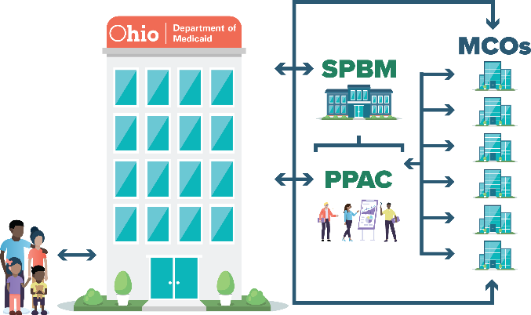
Single Pharmacy Benefit Manager (SPBM)
The Next Generation of Managed Care
The SPBM is a specialized managed care organization contracted with ODM to administer Ohio Medicaid’s prescription drug program.
ODM and stakeholders identified problems such as pricing, rebates, claw backs, fees, formulary, inaccessible data, contract steering, access to rural pharmacies, and dispensing fees, shaping the SPBM.
By directly contracting with ODM, the SPBM provides ODM greater ability to monitor quality, transparency and accountability in the pharmacy program.
WHO IS RESPONSIBLE? |  | OHIO MEDICAID
 | MCO | ODM | SPBM | PPAC
Pharmacy reimbursement and benefit design
Pharmacy benefits manager oversight and auditing
Pharmacy network management (retail and specialty)
Prescriber (physician) provider services
Pharmacy provider services
Member services
Utilization management
Claims adjudication and payment
Systems and technology
Data warehouse, analytics and reporting
Unified preferred drug list (UPDL)
Federal and state supplemental drug rebate processing
Clinical programs (MTM, care coordination, etc.)
Unbundling core functions of the pharmacy benefit allows ODM to identify and eliminate potential conflicts of interest.
With timely, consistent information to each of the MCOs, quality care is provided to all Medicaid members.
The SPBM increases data accuracy and timeliness, supporting program integrity, quality, and pay-for-performance initiatives.
Previously responsible
Responsible in Next Generation program

Slide 37
Ohio Medicaid SPBM: Greater Accountability and Transparency
The single pharmacy benefit manager (SPBM) partners with Ohio Department of Medicaid (ODM) to improve management and administration of pharmacy benefits for our members. This helps provide quality care for our members, transparency in operations, and responsible stewardship of Ohio taxpayer dollars.
SPBM contracts directly with ODM.
ODM requires predictable and fair pharmacy reimbursements and networks.
ODM has the tools to ensure the managed care pharmacy benefit is aligned to support integration with clinical services and provides true transparency.
New structure has checks and balances in place to prevent conflicts of interest.

Slide 38
SPBM Functions
PPAC Functions
Single Pharmacy Benefit Manager The SPBM consolidated the processing of retail pharmacy benefits and maintains a pharmacy claims system that integrates with the Ohio Medicaid Enterprise System (OMES), MCOs – including Aetna, the OhioRISE plan, pharmacies, and prescribers.
Support New Pharmacy Model The PPAC provides services to ODM to support the new pharmacy business model by:
Eliminating the “information black box” between ODM and current MCOs and their PBMs.
Providing consultation services to explore best practices.
Member Access to Medications The SPBM works to provide:
More pharmacy choices.
Fewer out-of-network* restrictions.
Consistent pharmacy benefits for all managed care members.
Managed Care Pharmacy Reimbursement and Benefit Design The PPAC supports pharmacy reimbursement and benefit design by:
Conducting Ohio Average Acquisition Cost (OAAC) surveys to develop a fair and transparent pricing model.
Assisting in development of value-based dispensing fees.
Improved Pharmacist and Prescriber Processes Pharmacists and prescribers see benefits from the SPBM model:
Streamlined processes.
Only need to work with one PBM rather than multiple contracted PBMs.
Streamline inventory based on a consistent and transparent preferred drug list.
Pharmacy Program Oversight and Auditing The PPAC provides oversight by:
Prohibiting any steering to related pharmacies by the SPBM.
Supporting ODM by conducting audits of the SPBM
Ensuring the SPBM does not receive unallowable rebates, refunds, clawbacks, or payments.
*Network considerations are only for managed care members.

Slide 39
Recent changes and Updates related to PNM
PNM Enrollment Agent Role: Edit Key Provider Identifiers, this change increases the ability of the Enrollment Agent role to update some additional demographic information.
PNM Administrator transfer – new ODM 10304. This form should be used when a practitioner moves to a different Medicaid provider and a new PNM Administrator needs to be assigned to their individual Medicaid ID to ongoing management of their provider data in the PNM.
Provider Enrollment Processing Average turnaround time:
15 - 20 business days
Credentialing Review and Completion Average turnaround time:
8 - 9 business days

Slide 40
PNM and Centralized Credentialing Updates
Public health emergency (PHE) Return to Routine Provider revalidations resuming October 2023
In-person site visits resuming for organizational providers August 2023
For independently licensed practitioners, revalidation and recredential dates are paired
Revalidations
Recredentialing
Federal Requirement
5-year provider agreement
All providers subject to this – including those that are under delegate agreement.
National Committee for Quality Assurance (NCQA) Requirement
3-year recredentialing requirement
Only Independently Licensed Practitioners are subject to NCQA credentialing/recredentialing.
Notes:
Speaker’s Notes: Bibi Manev / Angela Cage
In addition to our updates on the PNM we want to give you an update on Centralized Credentialing specifically the restart of revalidations and recredentialing.
The Public Health Emergency (PHE) Return to Routine Provider revalidations are resuming October 2023
In-person site visits resuming for organizational providers August 2023
For independently licensed practitioners, revalidation and recredential dates are paired.
Revalidations is…
A Federal Requirement
A 5-year provider agreement
And all providers subject to this – including those that are under delegate agreement.
While Recredentialing is
A National Committee for Quality Assurance or (NCQA) Requirement
A 3-year recredentialing requirement
And only Independently Licensed Practitioners are subject to NCQA credentialing/recredentialing.

Slide 41
PNM Provider Master File
The PMF includes all providers screened and enrolled with Ohio Medicaid. It also includes address and demographic information, provider affiliations, specialties and effective dates.
ODM also sends a daily Credentialing File to include all the practice information, and other information necessary for provider directories.
ODM sends a daily Provider Master File (PMF) to all the MCEs.
To learn more about ODM credentialing requirements, refer to OAC rule 5160-1-42

Slide 42
Provider Resource Information

Slide 43
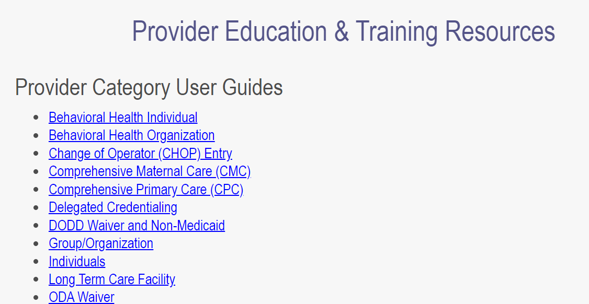
Accessing Provider Network Management Resources
PNM
Module
Adding a Hospital Affiliation
Affiliations
Revalidation
Self-Service Functions
Updating or Adding Practice Locations
Converting ORP to Standard (FFS)
3. Select the resource you are needing. Listed above are some of the most popular resources available to providers regarding the PNM module.
1. Navigate to the Provider Network Management (PNM) Module.
2. Click on the “Learning” button in the top navigation bar.
Access the Provider Network Management module at
https://ohpnm.omes.maximus.com/OH_PNM_PROD
43

Slide 44
Who can providers reach out to if they need help?
Help Desk | Who Should Call? | Types of Issues/Questions Supported
ODM Integrated Helpdesk (IHD) 800-686-1516 or IHD@medicaid.ohio.gov Provider representatives are available Monday - Friday 8 a.m.-4:30 p.m. Interactive Voice Response System (IVR) provides 24/7/365 access to information regarding client eligibility, claim and payment status, and provider information. | Current Ohio Medicaid providers/prescribers Current OhioRISE providers/prescribers Providers interested in enrolling with Ohio Medicaid | OMES submitted claims, prior authorization, and other administrative tasks General Medicaid member eligibility questions General Medicaid payment/billing questions and issues Enrolling as an Ohio Medicaid provider Provider Network Management (PNM) module OH|ID or portal password support Centralized credentialing Using the CANS assessment tool and CANS IT system
Managed Care Entity (MCE) Provider Hotlines (includes Aetna OhioRISE plan) Contact information and hours vary by MCE, information is available on page 2. | Current Ohio Medicaid providers contracted with the MCE Providers interested in contracting with the MCE Providers with questions about claims, billing | MCE member claims, payment/billing questions and issues MCE prior authorization for a member with the MCE Verifying a member’s MCE eligibility Contracting with the MCE
Gainwell Single Pharmacy Benefit Manager (SPBM) Customer Support Center 833-491-0344 or OH_MCD_PBM@GainwellTechnologies.com 24 hours a day, 7 days a week | Gainwell-contracted pharmacists and pharmacy staff Current Ohio Medicaid providers/prescribers Current OhioRISE providers/prescribers | Assistance or issues with pharmacy claims, prior authorizations, and/or other administrative pharmacy tasks Information about Ohio Medicaid’s SPBM and pharmacy program
Notes:
(*** THIS IS A RESOURCE- you do not need to talk through all slide details***

Slide 45
Who can providers reach out to if they need help? Continued.
Manage Care Entity | General Provider Inquiry Phone Number | General Provider Inquiry Email | Web Portal | Provider Contracting Phone Number | Provider Contracting Email
AmeriHealth Caritas Ohio, Inc. | 1-833-644-6001 | OhioProviderServices@amerihealthcaritasoh.com | https://navinet.navimedix.com/plan-central/acoh | 1-833-296-2259​ | ProviderRecruitmentOH@amerihealthcaritas.com
Anthem Blue Cross and Blue Shield | 1-844-912-1226 | OhioMedicaidProvider@anthem.com | https://apps.availity.com/availity/web/public.elegant.login | 1-800-462-3589 | OhioMedicaidProvider@anthem.com
Buckeye Health Plan | 1-866-296-8731 | N/A | https://www.buckeyehealthplan.com/login.html | 1-866-246-4358 | OHNegotiators@CENTENE.COM
CareSource Ohio, Inc. | 1-800-488-0134 | CustomerAdvocacyCommunication@CareSource.com | https://providerportal.caresource.com/GL/SelectPlan.aspx | 1-800-488-0134 | Ohio_Provider_Contracting@caresource.com ​
Humana Healthy Horizons in Ohio | 1-877-856-5707 | N/A | https://www.availity.com | 1-877-856-5707 | ohionetworkspecialist@humana.com
Molina Healthcare of Ohio, Inc. | 1-855-322-4079 | N/A | https://provider.molinahealthcare.com | 1-855-322-4079​ | OHContractRequests@MolinaHealthCare.com ​
UnitedHealthcare Community Plan of Ohio, Inc. | 1-800-600-9007 | ODMEDI_HELPDESK@uhc.com | https://www.uhcprovider.com | 1-​800-600-9007​ | Governmentaffairsohio@uhc.com
Aetna Better Health of Ohio | 1-833-711-0773 | OHRISE-Network@aetna.com | https://apps.availity.com/availity/web/public.elegant.login | 1-855-364-0974 | OHRISE-Network@aetna.com
Notes:
(*** THIS IS A RESOURCE- you do not need to talk through all slide details***

Slide 46
BUDGET AND OTHER BH RELATED POLICY

Slide 47
Other ODM BH Policy
Workforce
MyCare
MRSS & crisis continuum
SUD waiver and residential/treatment continuum
TT-TC and developing policy re: those incarcerated

Slide 48
MyCare

Slide 49
MyCare Conversion Charter and Principles Moving to the Next Generation of Managed Care for Individuals Dually Eligible for Medicare and Medicaid
Threshold Decisions
Ohio Submitted Plan for the Next Generation of MyCare as a managed care program 9/30/2022
Build on the Next Generation platform
Use a similar stakeholder input process as Medicaid Next Gen
Address four federally required elements of the plan:

Slide 50
Required elements of the Conversion Plan
Conduct a stakeholder engagement process
Maximize integration attained through MyCare and convert to integrated D–SNPs, aligning with the Next Generation managed care requirements.
Sustain dedicated ombudsman support without federal grant funding.
Specific policy and/ or operational steps required for the conversion.
*With the submission of a 10/1/23 plan, Ohio has until no later than 12/31/2025 to transition 5

Slide 51
Maximize integration attained through MyCare & convert to integrated D–SNPs, aligned with the Next Generation managed care requirements
The Starting Point for Discussion with Stakeholders
We propose to transition the current MyCare program to a Fully Integrated Dual Eligible Special Needs Plan (FIDE SNP) model with fully aligned enrollment in a companion Medicaid managed care plan (MMC) subject to the Next Generation program requirements:
As a starting point for the discussion the same geographic territories as they exist in MyCare today
Serving individuals 21 years of age and older (change from today)
Same benefit package, recognizing each MMP provides value added benefits
Choice to opt in or opt out of Medicare managed care will remain
Self-direction will be streamlined, making it amenable to greater use by individuals.
Care coordination has a variety of issues that will be discussed, and modifications considered. For example, the large number of younger individuals who have significant mental health needs, while benefiting from the integration of their care, may require changes to the care coordination model to meet their needs.

Slide 52
Operational & Policy Considerations and Pain Points Transition to Next Generation Managed Care Requirements
Person centered care
Reducing burden on providers and streamlining the overall consumer and provider experience
Use of new OMES modulars, including transparency, accountability, central clearinghouse for prior authorizations. (SPBM, FI, PNM, Centralized Credentialing)
Coordination of Care
Network Adequacy and Delegation/Sub-Delegation Relationships
Individuals with Significant Behavioral Health Needs
Provider Appeals
Non-Emergency Transportation (NEMT)

Slide 53
MyCare Conversion Charter
Helpful Links:
https://medicaid.ohio.gov/about-us/notices/mycare-conversion-charter
https://medicaid.ohio.gov/static/About+Us/PublicNotices/Sept22+MyCare+Conversion+Charter+w-attach.pdf
mycareconversionquestions@medicaid.ohio.gov

Slide 54
Thank you for all you do

