Slide 1

Overview of Veterans Services & the OhioCares Initiative

Slide 2
Federal Services
Disability / Pension
Medical Care
VA Cemetary /Burial
Caregiver / Survivor
Home Loan
Education
County Services
Claims Assistance
Financial Assistance
Transportation
State Services
Employment Support
Scholarships / Tuition Waivers
Hunting / Fishing / Boating
Special License Plates
High School Diploma Program
Ohio Veterans Bonus
County Veterans Services Offices are central point of access

Slide 3
US Department of Veterans Affairs
www.va.gov/directory/GUIDE/home.asp
VHA
5 x Medical Centers
33 x Outpatient Clinics
VBA
Cleveland Regional Office
(Claims Processing)
VCA
Dayton National Cemetery
Ohio Western Reserve National Cemetery
7 x Vet Centers
VISN-10 Central Office
Cincinnati

Slide 4
Director
Veterans Services
Veterans Homes
Office of Communications
Office of Policy & Veterans Programs
Office of the State Approving Agency (GI Bill)
Office of Education & Compliance
Veterans Workforce Team
Sandusky
Georgetown
CVSO Training & Certification
VBA Regional Office Liaison
Governor
www.ohiovets.gov

Slide 5
Benefits &
Services
CVSO
VA
Medicaid
BMV
Licensing
Plates
CDL
Education
ODHE
USO
ODE
Employment
ODJFS
JobsOhio
Licensure
Employers
Financial
Taxation
Treasurer
Homeless
VA
Local CoC
Legal/Justice
Courts
AG
DRC
VA
Military
Guard
Reserve
Active Duty
Mental Health
MHAS
Boards
VA
OSPF
Records
DOD/DPRIS
CVSO
Archives
Voting
Sec of State
Ohio Military/Veteran Service Network
= Educate/Engage/Influence/Partner

Slide 6

OhioCares www.ohiocares.ohio.gov

Slide 7

OhioCares is the State of Ohio's permanent institutional expression of the collaboration built by the Governor's Challenge.
OhioCares will create a single point of collaboration between state, federal, and local government agencies, non-profit entities, and community organizations to build a more "veteran-informed" community behavioral health system in Ohio.

Slide 8
OhioCares Terminal Learning Objectives
1) Understand the role and purpose of the OhioCares collaborative in support of the military/veteran community
2) Become familiarized with the OhioCares website and the resources available to veterans, servicemembers, families, and community partners
3) Recognize opportunities to leverage OhioCares information and partner organizations in support of military/veteran community clients

Slide 9
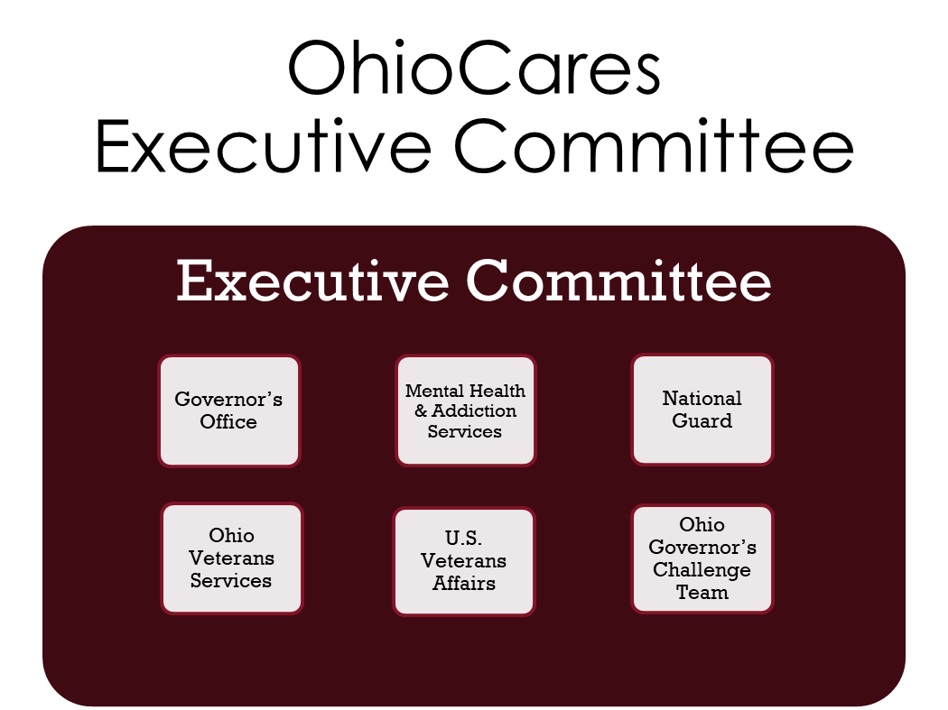
Establish state cabinet-level executive committee to coordinate state programmatic and budgetary authority;
Build local community capacity to serve and support the veteran and military community through engagement and education. (SMVF, Providers, Community, State/Federal/Local Government Partners)

Slide 10
Statewide Workgroup
Executive Committee
Ohio Brain Injury Program
Ohio Veterans Homes PRS Program
Ohio National Guard Unit Support Teams
Governor’s Office
Mental Health & Addiction Services
Ohio Suicide Prevention Foundation
Ohio Medicaid
Local Behavioral Health & Family Services Providers
National Guard
Ohio Veterans Services
County Veterans Services Offices
Alcohol, Drug Addiction &Mental Health Boards
Red Cross
Ohio Governor’s Challenge Team
U.S. Veterans Affairs
Selected Priority Workgroups
>
Community Engagement
Provider Engagement
Executive Committee coordinates key state agencies in support of statewide and priority workgroups
Statewide Workgroup provides the platform for the Executive Committee to Engage and Coordinate with partners
Selected Priority Workgroups organized to support community initiatives and efforts seen as essential to supporting the behavioral health needs of Ohio’s servicemembers, veterans, and their families

Slide 11
Current Priority Workgroups
Provider Engagement
Engage providers on a statewide basis regarding training and education opportunities on mil/vet culture and behavioral health needs (SBHP, PsychArmor, etc.)
Promote participation in the Star Providers Registry and VA Community Care Program
Community Engagement
Focus on engaging the broader community of local mil/vet supporting organizations and family support organizations (CVSOs, Vet Orgs, Red Cross, etc.)
Engage non-veteran community organizations in faith-based, Appalachian, and minority communities
Support lethal means safety efforts
Engage with community crisis support and suicide prevention efforts (local prevention coalitions)

Slide 12

OhioCares Liaisons
Ohio Department of Mental Health and Addiction Services
Adreana Tartt, Adreana.Tartt@mha.ohio.gov
Office of the Medical Director, Bureau of Cultural Competency/Special Populations
Ohio Department of Veterans Services
Daniel Eakins, Daniel.Eakins@dvs.ohio.gov
Office of Veteran Policy and Programs
Ohio National Guard
Colin Fowler, colin.b.fowler.ctr@army.mil
Psychological Health Coordinator

Slide 13
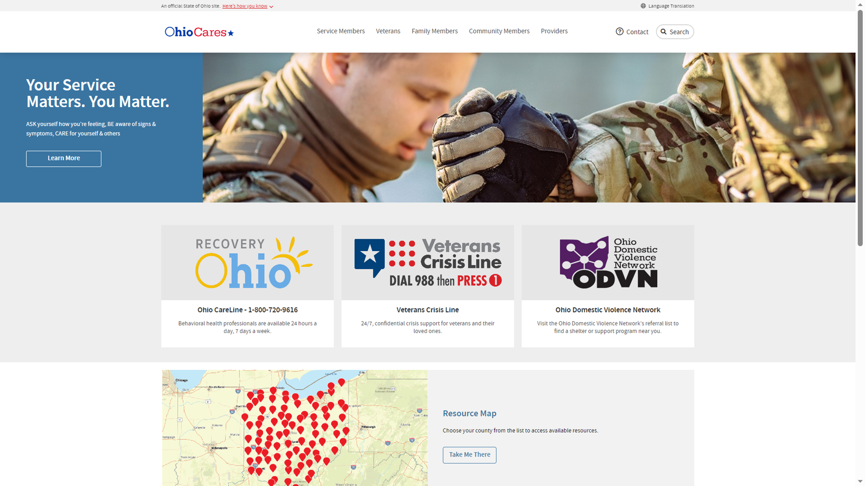
OhioCares Website Review
www.ohiocares.ohio.gov

Slide 14
SBHP Registry
309 providers
serving clients in
338 locations
Providers are located in 75% of Ohio counties
(65 of 88 counties)
2022-2023* Participation
Tier 1 234
Tier 2 73
Tier 3 53
Tier S 9
Lifetime Participation
Tier 1 2451
Tier 2 1088
Tier 3 703
Tier S 106
www.starproviders.org

Slide 15
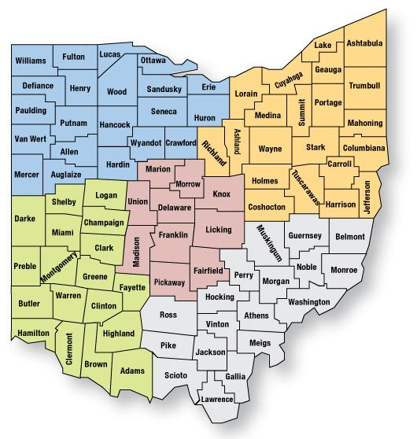
Ohio Regions by County –Certified Veteran Peer Supporters
Adams | 1
Butler | 1
Clark | 1
Clermont | 1
Columbiana | 1
Cuyahoga | 15
Drake | 2
Delaware | 1
Erie | 3
Fairfield | 2
Fayette | 1
Franklin | 10
Greene | 1
Hamilton | 4
Hardin | 1
Henry | 1
Huron | 1
Lake | 1
Licking | 3
Logan | 1
Lorain | 5
Mahoning | 1
Marion | 1
Montgomery | 5
Muskingum | 2
Noble | 1
Ottawa | 1
Pike | 1
Portage | 1
Richland | 1
Ross | 3
Scioto | 3
Shelby | 1
Stark | 2
Summit | 4
Tuscarawas | 1
Washington | 2
Wood | 1
8
North West
12
South East
32
North East
17
Central
19
South West
38
Certified Veteran Peer Supporter

Slide 16

Remaining Training Dates FY 23
Upcoming PRS Trainings
Oct 16th – 27th: 10 AM – 3 PM
Dec 4th – 15th: 4 PM – 9 PM
Tentative 2024 Dates
Feb 5th – 16th: 4 PM – 9 PM
May 13th – 24th: 10 AM – 3 PM
July 15th – 26th: 4 PM – 9 PM
Oct 21st – Nov 1st: 10 AM – 3 PM
Dec 9th – 20th: 4 PM – 9 PM

Slide 17
Key Contacts
Star Behavioral Health Providers Training
Brei E. Miller
Program Director
Ohio Brain Injury Program
O: 614-293-8879
brei.miller@osumc.edu
www.starproviders.org
ODVS Peer Recovery Supporter Training
Julian Walk
Program Manager
D: 567-998-4220
Julian.Walk@dvs.ohio.gov

Slide 18

Danny Eakins
Administrator, Office of Veteran Policy & Programs
77 S. High Street, 7th Floor
Columbus, Ohio 43215
D: 614.728.4928
daniel.eakins@dvs.ohio.gov
www.OhioVets.gov | www.OhioCares.ohio.gov
Serving Those Who Served

